Slide 1

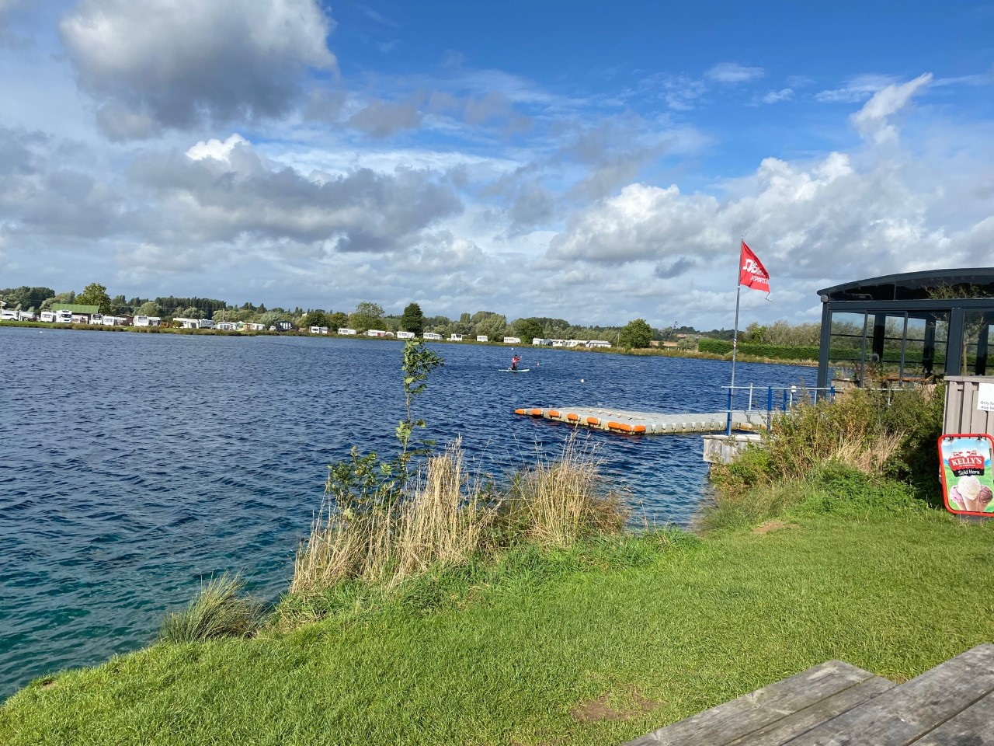
Holymead Year 6 Residential 2026
Monday 18th May –
Wednesday 20th May 2026
https://www.croftfarmwaterpark.com/

Slide 2

Ethos of camp
The ethos of the camp is very much to encourage to children to take part in as many activities as they can.

Slide 3
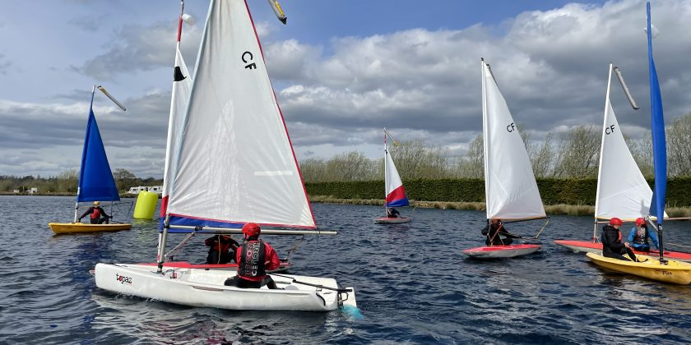
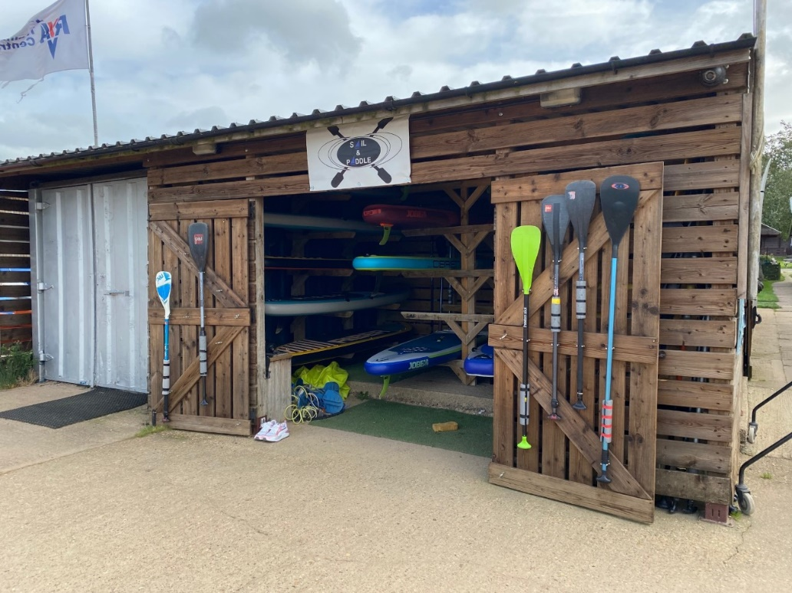
Activities
Staff are trained to the national standard and have lots of experience
These will include activities such as:
Kayaking
Canoeing
Archery
Raft building
Sailing
Team challenges
Nb: activities will be confirmed 2 weeks before departure
Children will be working in groups of approx. 12

Slide 4
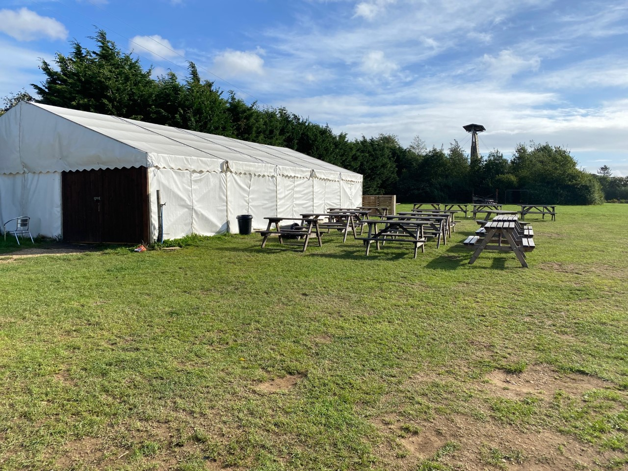
Activities
Water activities will be 3 hours long alongside a land based activity lasting 1 ½ hours.
This will then be followed by an evening activity.
There will also be some opportunities for free time
Nb: activities will be confirmed 2 weeks before departure
Activities will run on into the evening

Slide 5
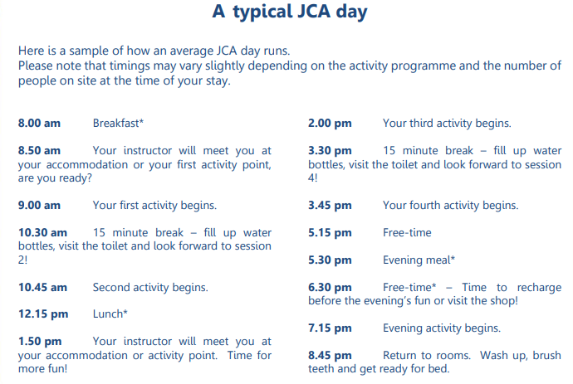

Slide 6
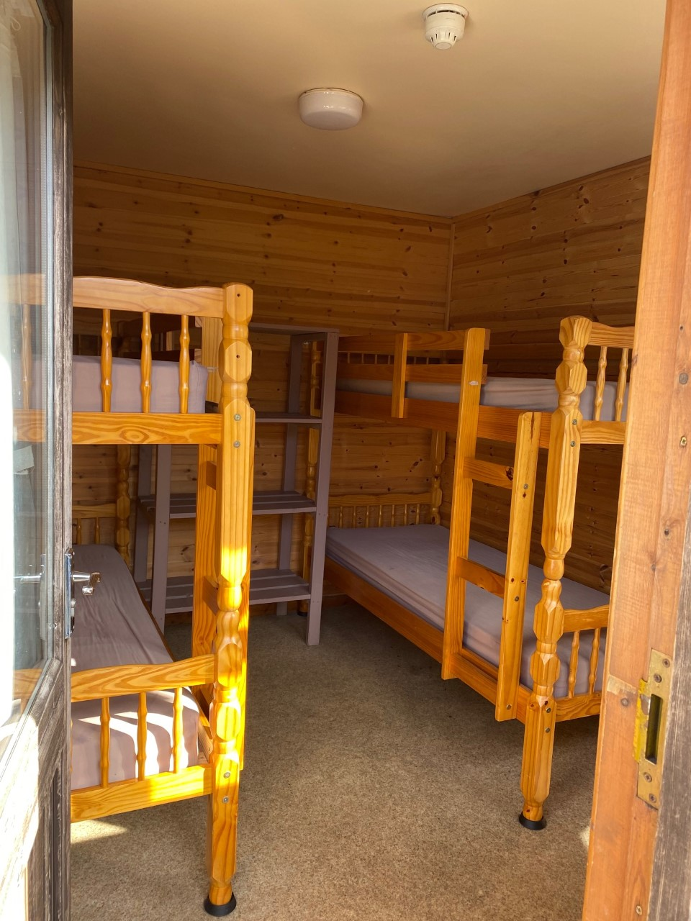
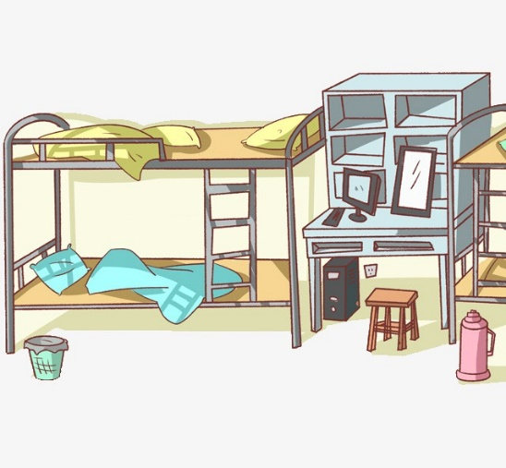
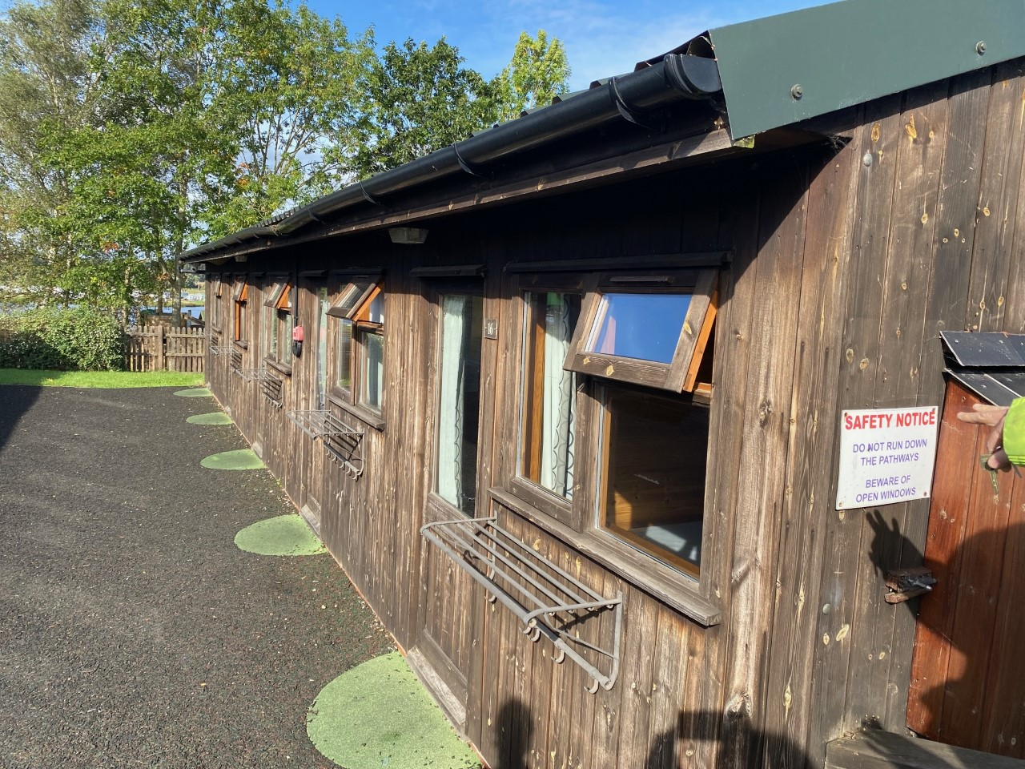
Sleeping arrangements
Children sleep in dorms of 4.
We will organise which room the children will sleep in but please be reassured that the children will be placed with their friends.
There will be a member of staff on each end of the dormitories and the area is secured throughout the night.

Slide 7
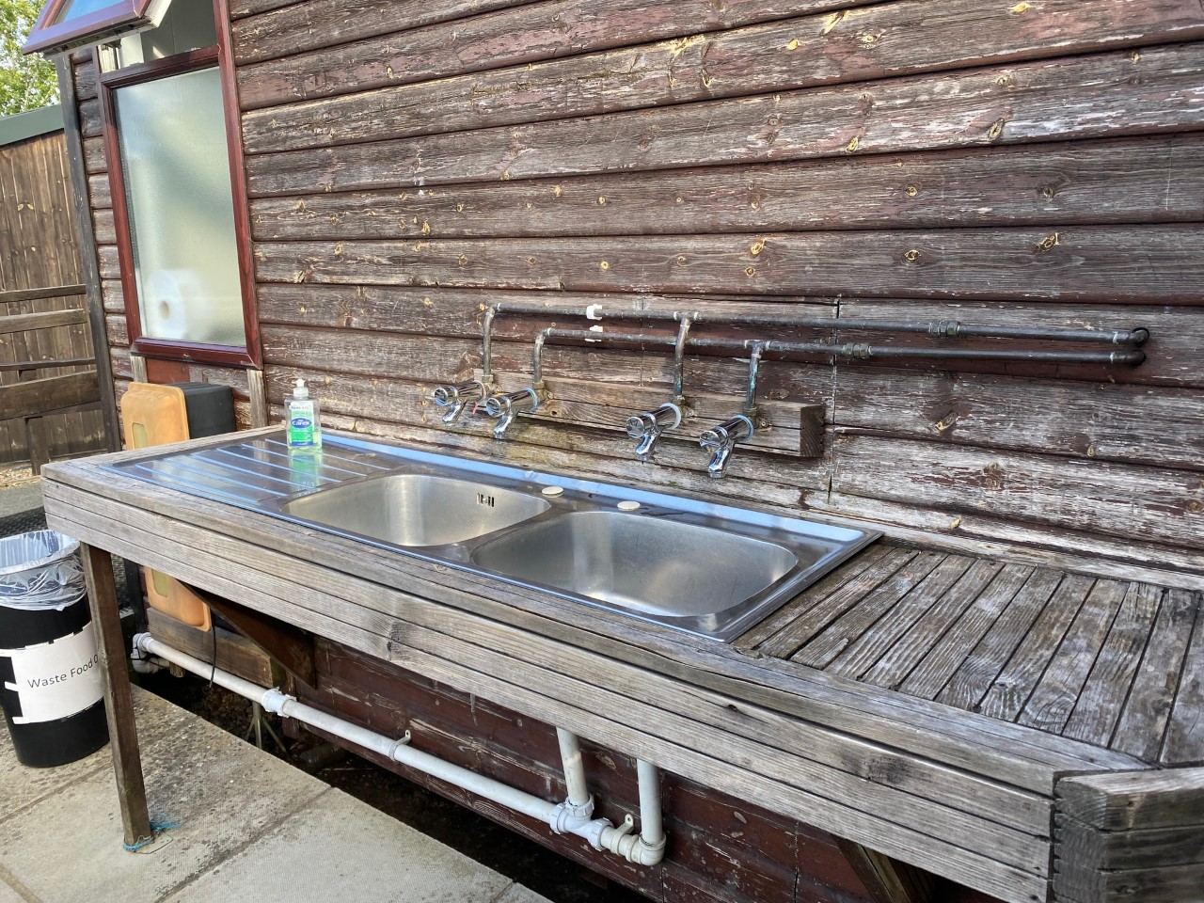
There is a separate toilet and shower block for girls and boys
Water refill station and handwashing spot too.

Slide 8

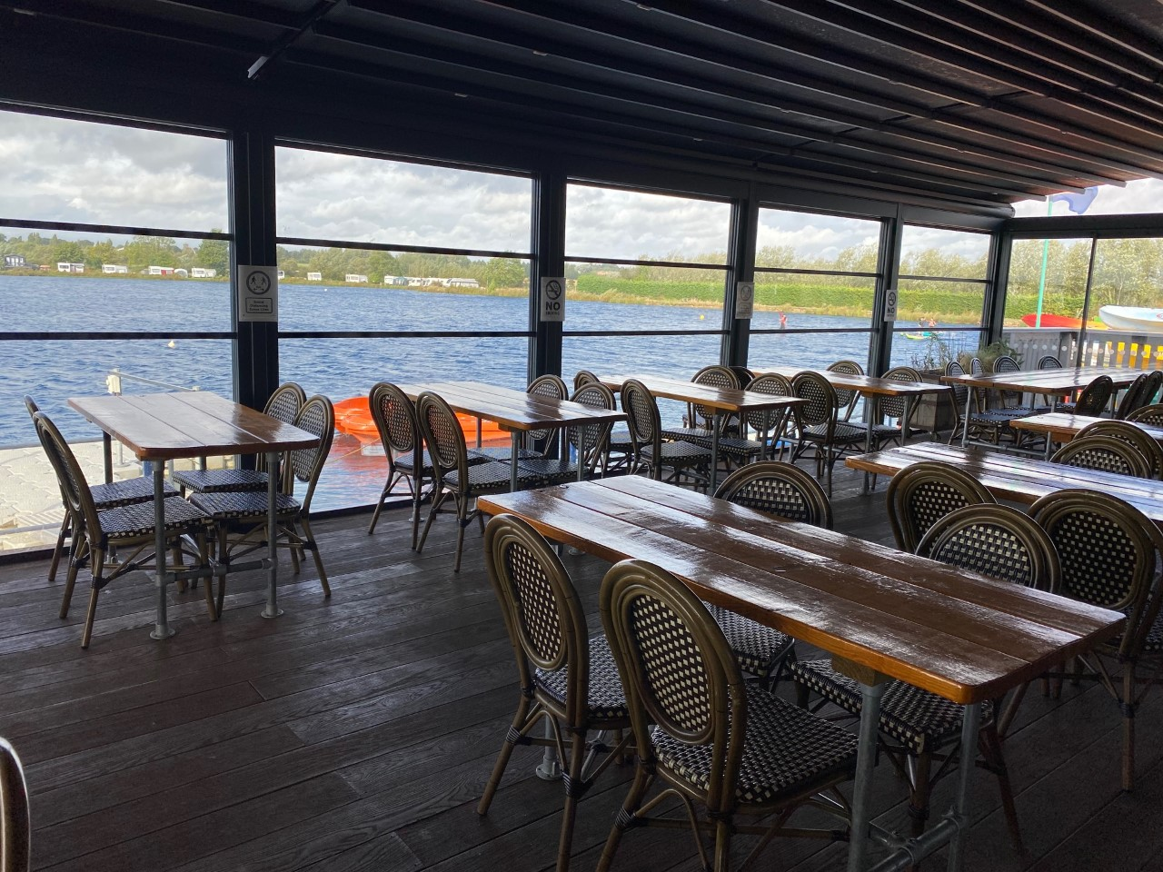
Meal times:
The camp will be informed of any dietary requirements

Slide 9
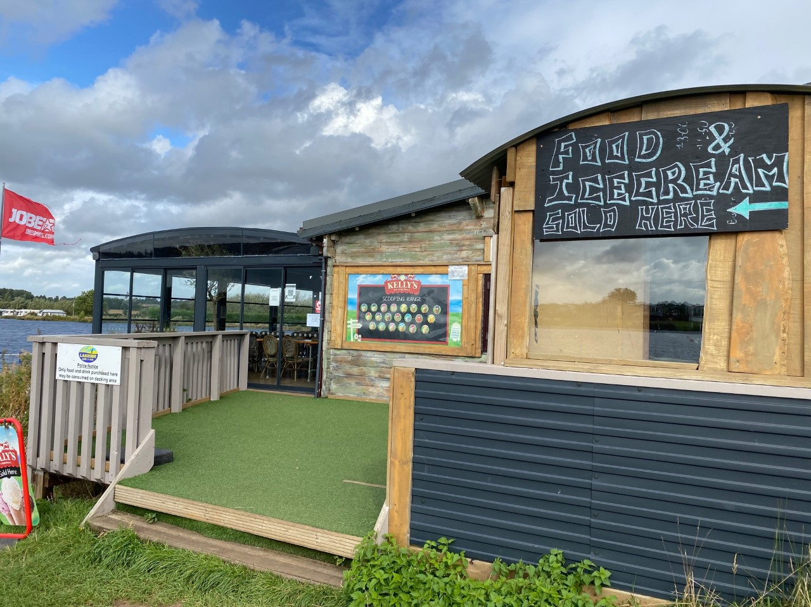
Pocket money
There is a small shop for children to buy snacks.
Bring up to (no more than) £10 in pound coins.

Slide 10
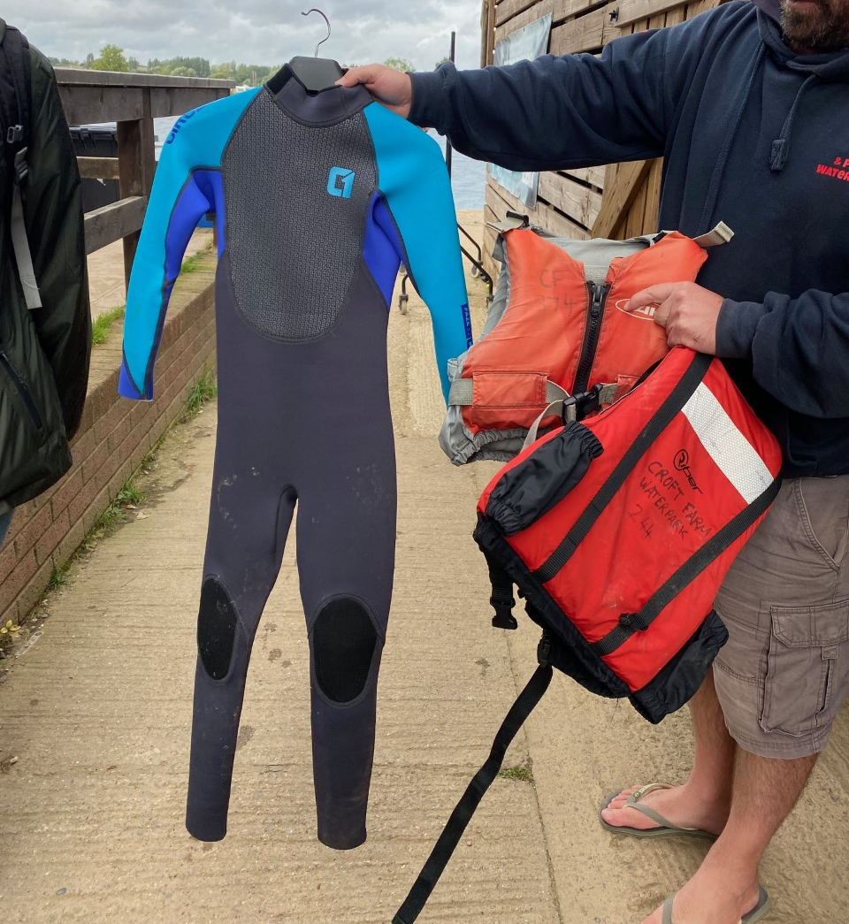

What to bring:
Please ensure your children have lots if warm clothes to change into - lots of layers are preferable.
Please see the kit list for more information
All kit is provided and as expected, all children will wear life jackets whilst taking part in water sports

Slide 11


What to bring
Sleeping bag and pillow
Lots of layers
Old trainers – a couple of pairs if possible
Waterproof / windproof jacket
Note:
Jeans aren’t a great idea as they become heavy an uncomfortable if they get wet.
Lots of jogging bottoms / legging and layers is ideal.
Get your child to pack themselves as much as possible so they know what they’ve brought and will know if they've lost anything
For more detailed information, please see the kit list on the Year 6 page of the website.
Phones are not permitted!

Slide 12
What to bring:
All kit is provided and as expected, all children will wear life jackets whilst taking part in water sports

Slide 13

Medical information
Medical forms:
These can be found on Year 6 page of the website.
https://www.holymeadp.bristol.sch.uk/page/?title=Welcome+To+Year+6&pid=89
Please ensure you have included your child’s National Health no. on the form and are returned by Friday 1st May 2026

Slide 14

Payments:
Price of camp: £322.06 ( not including the £80 deposit)
We are requesting payments as per the following payment plan:
£80.02 to be paid by 31st January 2026
£80.02 to be paid by 31st March 2026
Final amount of £80.02 to be paid by 11th May 2026. If full payment is not received by this date, the cancellation policy may be invoked and your child’s place on camp revoked.

Slide 15
Departure and arrival back to Holymead
Depart Holymead at 11 am on Monday 18th May 2026
Bring your child in no later than 10 a.m
If you have work commitments that do not allow you to do this, bring your child in at the normal start of the school day (8:50)
Arrive back at Holymead approx. 2:30 on Wednesday 20th May 2026
You can pick your child up once they arrive back at school (the office will contact you when we arrive back).
Alternatively, you can pick them up at the end of the school day (3:20 p.m)

Slide 16


Queries
If you have any further queries, please email the office and someone will get back to you. Alternatively, come and speak to Ms O’Toole
In the meantime, take a look at the Croft farm website at:
https://www.croftfarmwaterpark.com/

