Slide 1
Tregoyd House 2020
Wales
Monday 22nd June – Wednesday
24th June
Staff going – Mrs May, Ms Kosir, Miss Lynds, Mr Hough and Miss Morris.

Slide 2
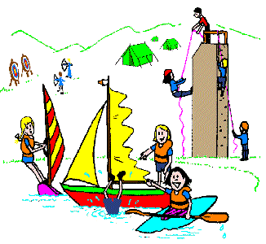
Activities
Need to be confirmed. We have requested these – Find out 4 weeks before – we can send this to you via parentmail. Kit list
Canoeing
Obstacle Course
Climbing
Abseiling
Orienteering
Zip wire / Climbing
Archery
disco on the final evening

Slide 4
Meal times
Breakfast and lunch served in a hall.
Hot food for every meal.
Vegans, vegetarians, gluten free and halal catered for.

Slide 5
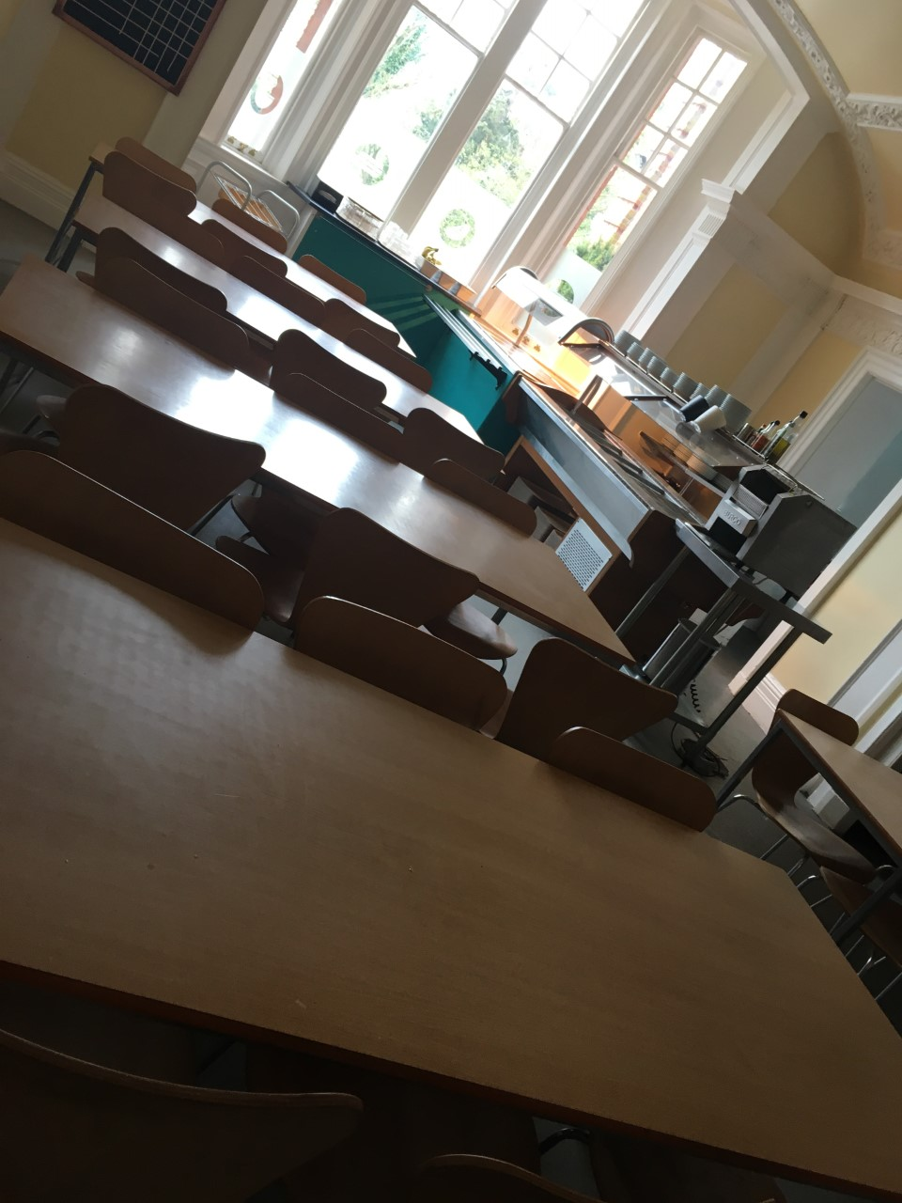

Slide 6
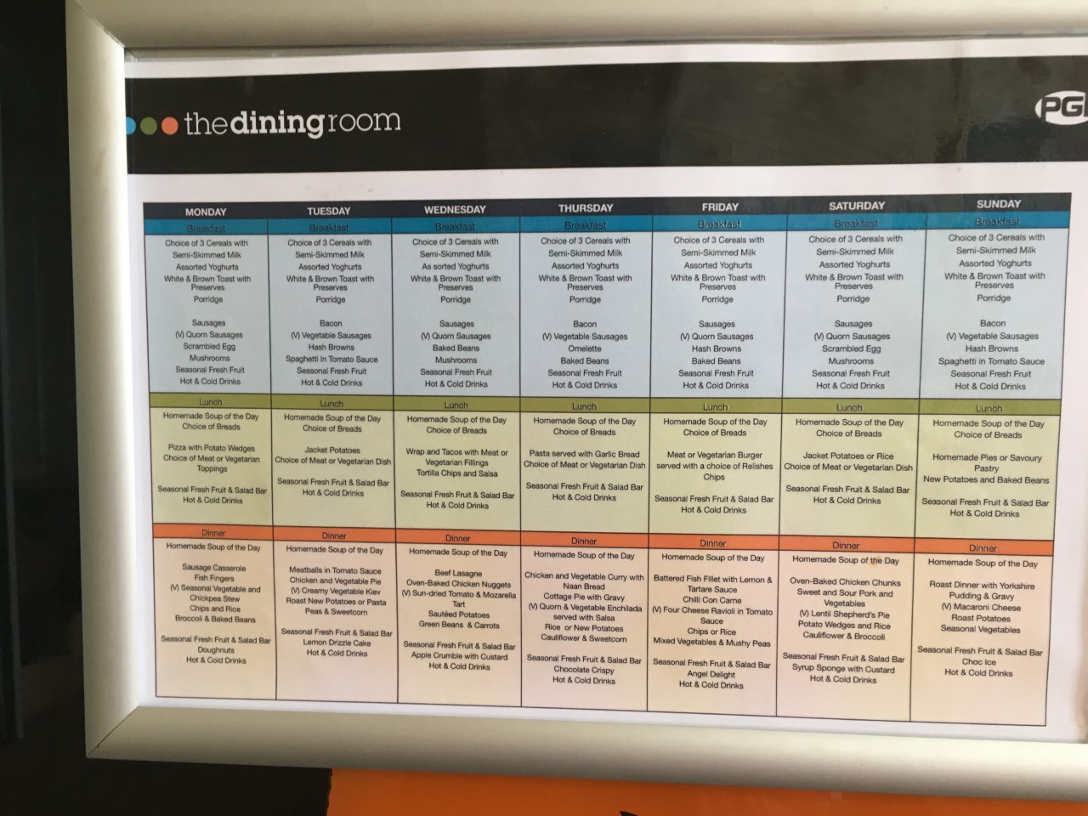

Slide 7
Food
The children are provided 3 hot meals a day.
They have opportunity to go the tuck shop twice.
We ask that they don’t bring any food/sweets/fizzy drinks other than their lunches that they need on the first day.
The main reasons for this are –
Sickness in the rooms and on coaches.
Allergies
They are able to buy sweets and chocolates from the shop.

Slide 8
Ethos of the camp

Slide 9
Timings for the week
Monday June
Children gather in Lower Hall at 8:50am. Coach departs at 9:30am.
Register and give medicines and money.
Wednesday June
^{Normally} back by the end of the school day. You will be informed by text if we are late. They are dismissed from lower hall.

Slide 10
On arrival
The children will eat lunch, unpack their bags and will begin their first activity. They will have a tour of the site first

Slide 11
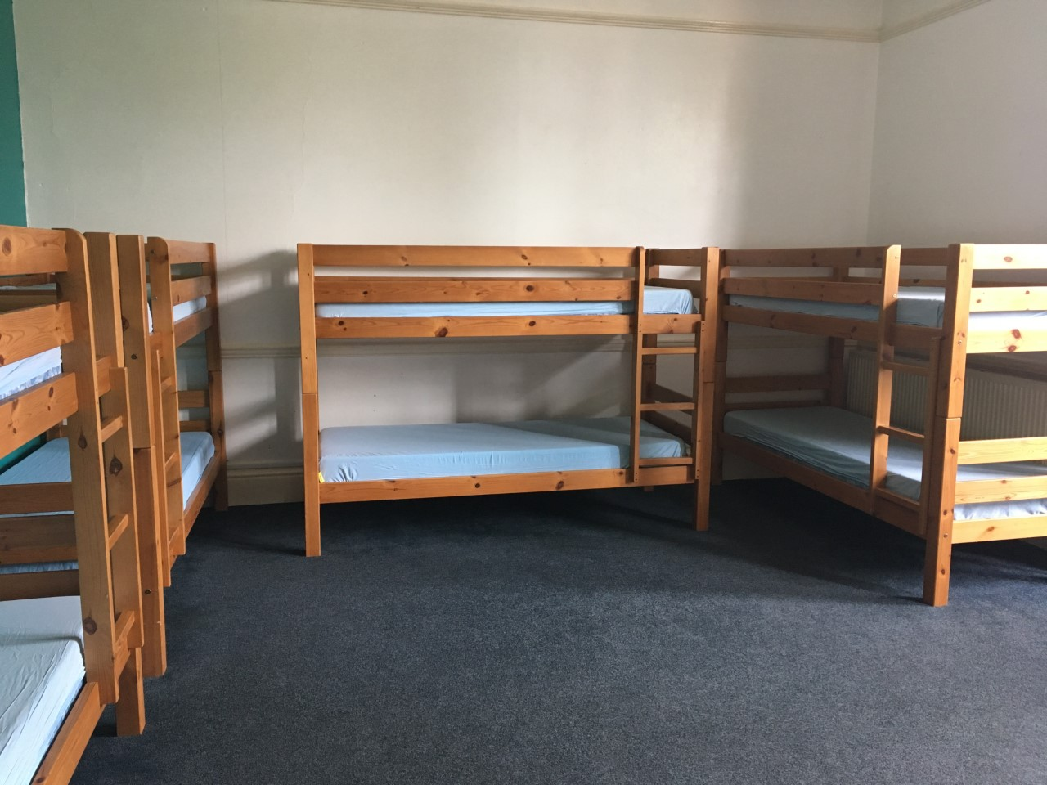
Sleeping and group arrangements

Slide 12
Medical information
Please ensure these are completed and given back promptly
You will need to bring any medication
You have mentioned on the forms.
We have calpol, sanitary towels, piriton
Sudocream and plasters. There is registered
First aider always on site.

Slide 13
What to bring!
Jeans aren’t a great idea! Apart from for DISCO NIGHT!
Get your child to pack themselves as much as possible so they know what they’ve brought and will know if they've lost anything
Phones are not permitted!

Slide 15
The children are split into groups of about 10. There is an adult from the school with them the whole time.
They are in these groups all day and mix for meal times.

Slide 16
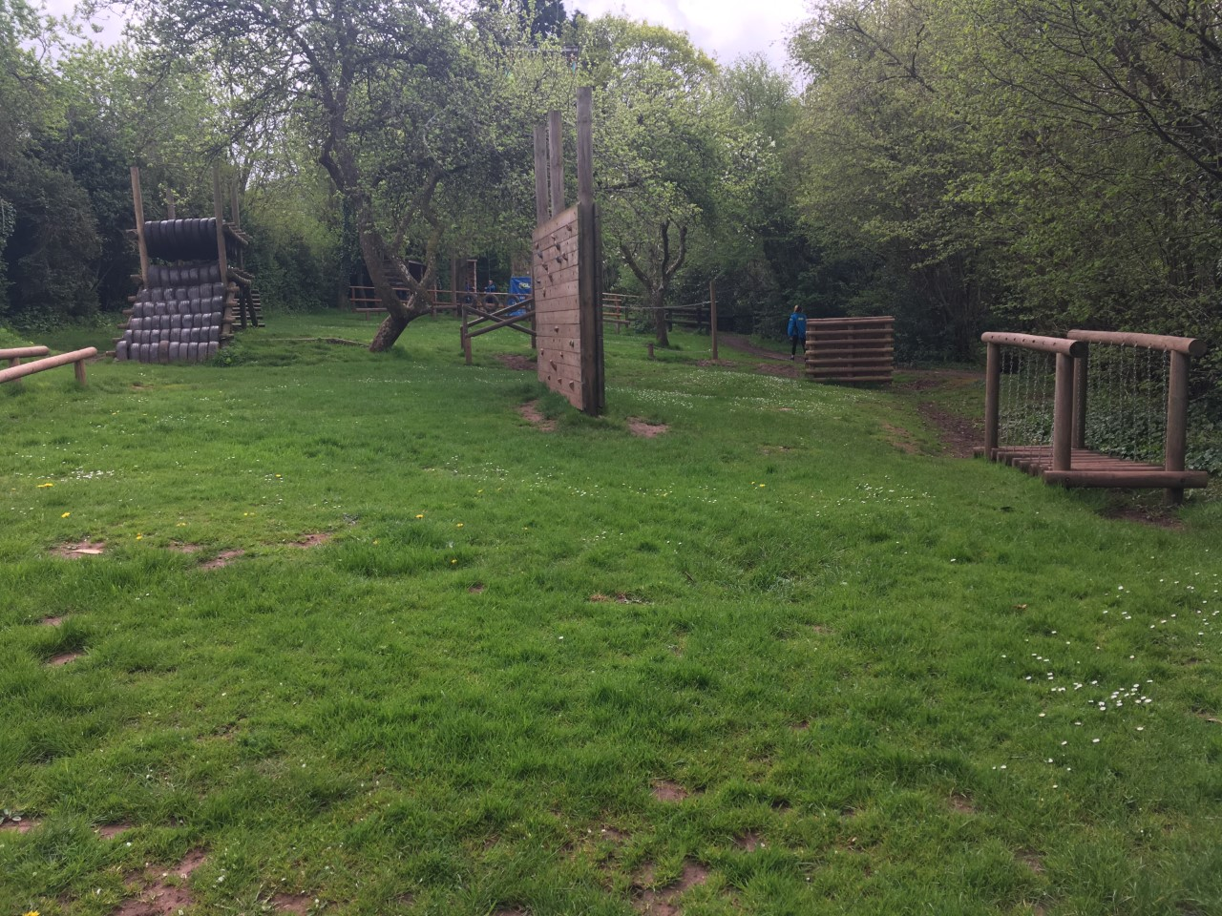

Slide 19
Any questions

