Slide 1


Slide 2
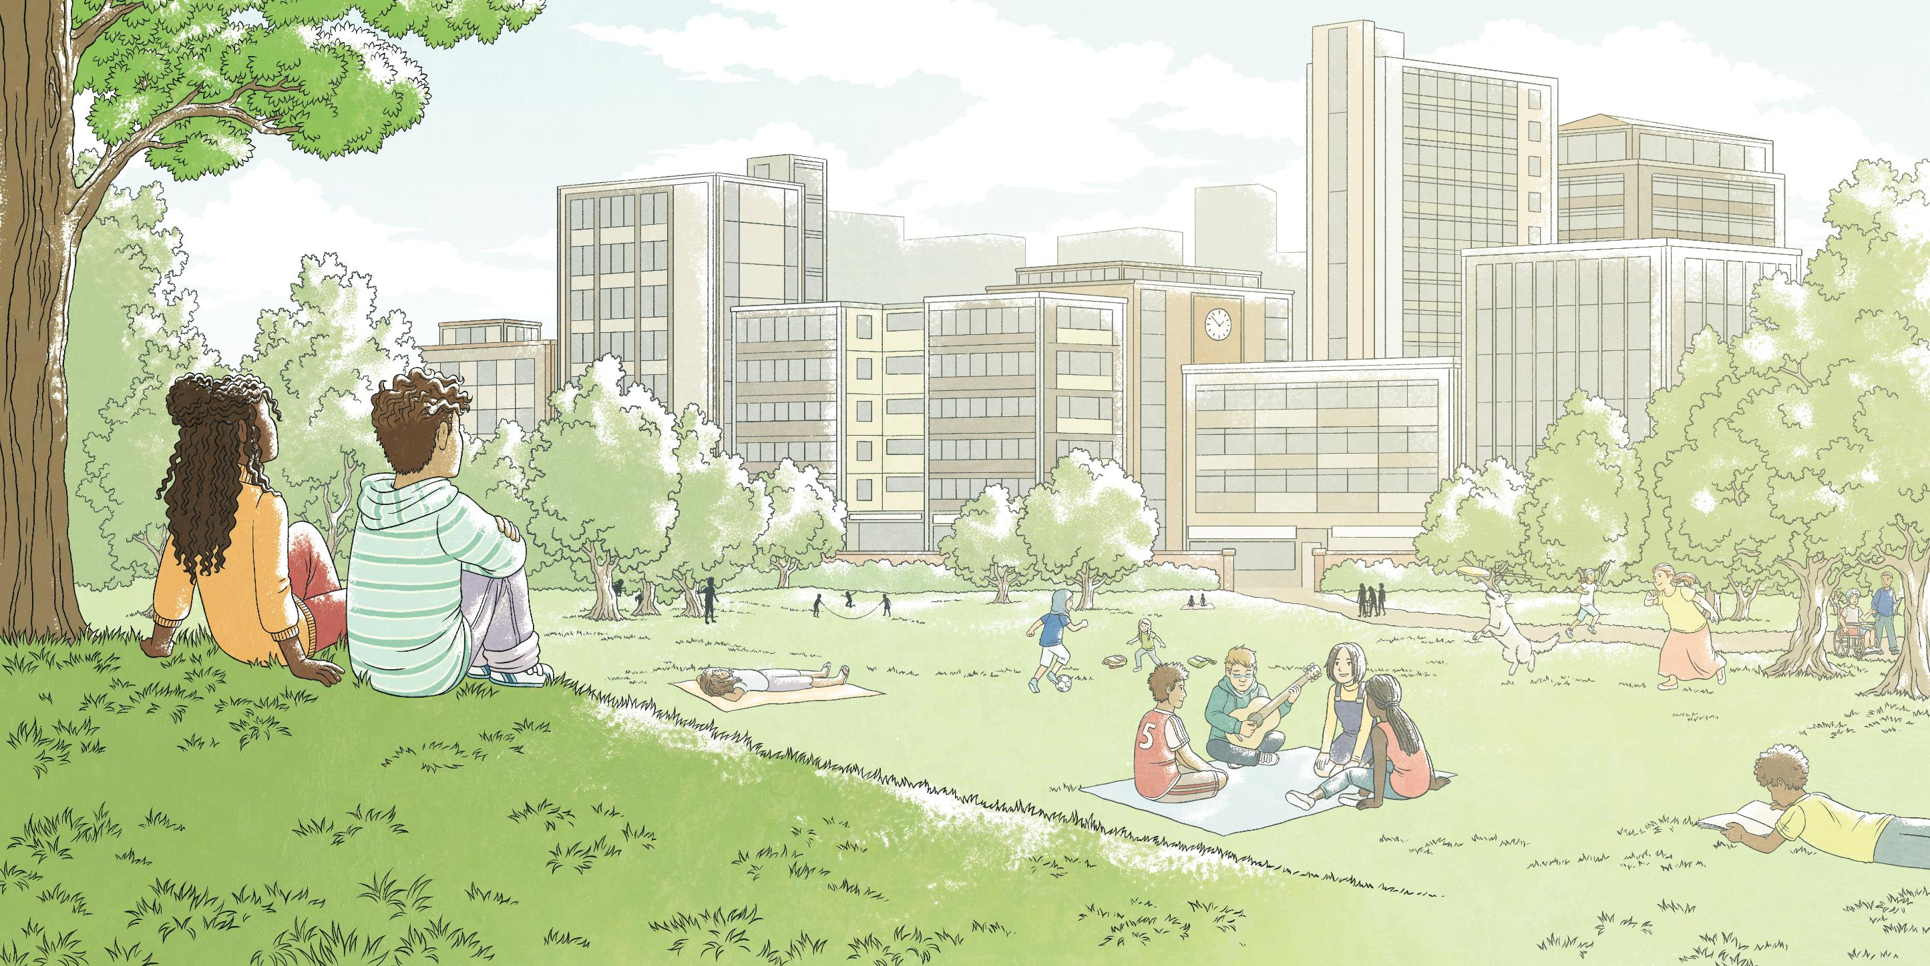

Slide 3
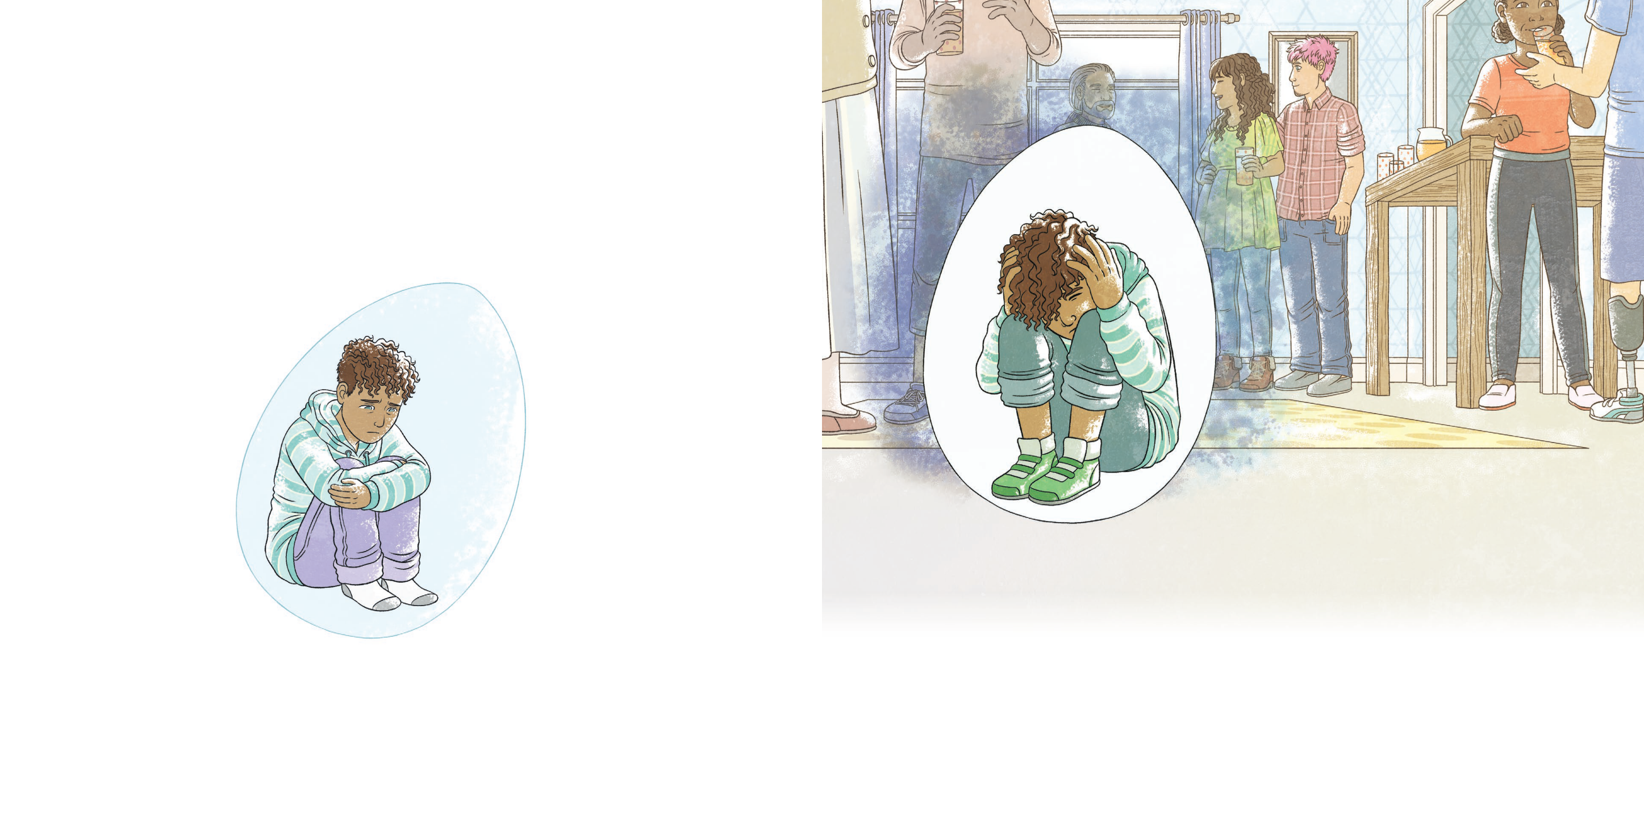
Enzo’s egg was a space just for him.
It was a place where he found himself when there were lots
of noisy people...

Slide 4
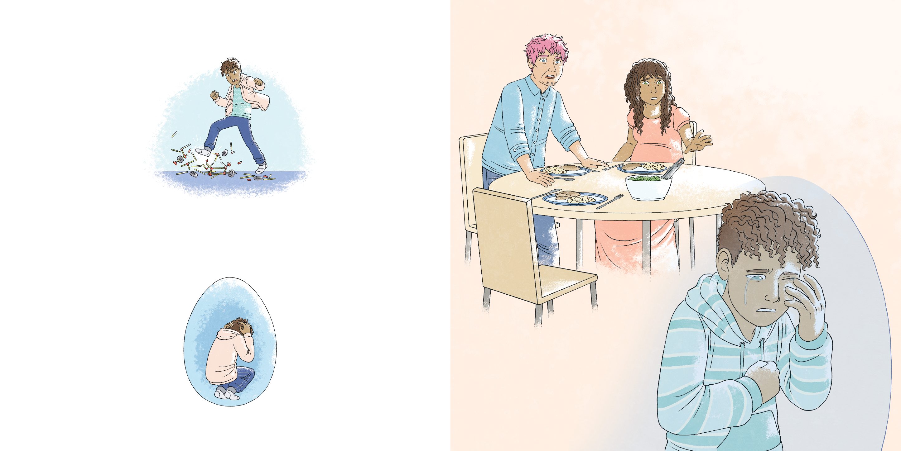
...or cry...
...when he wanted to shout...

Slide 5
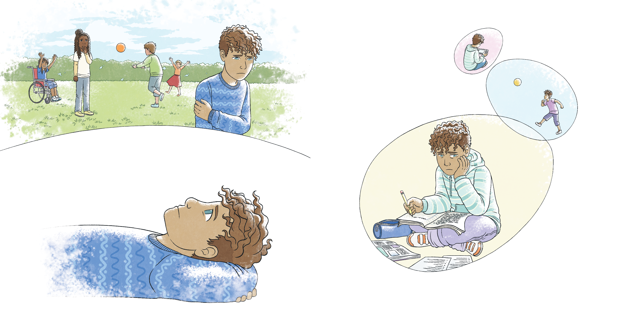
Recently, Enzo had needed
the egg more and more. It was where he wanted to be.
…or when he needed time to reflect.
So, he decided to stay for a while.

Slide 6
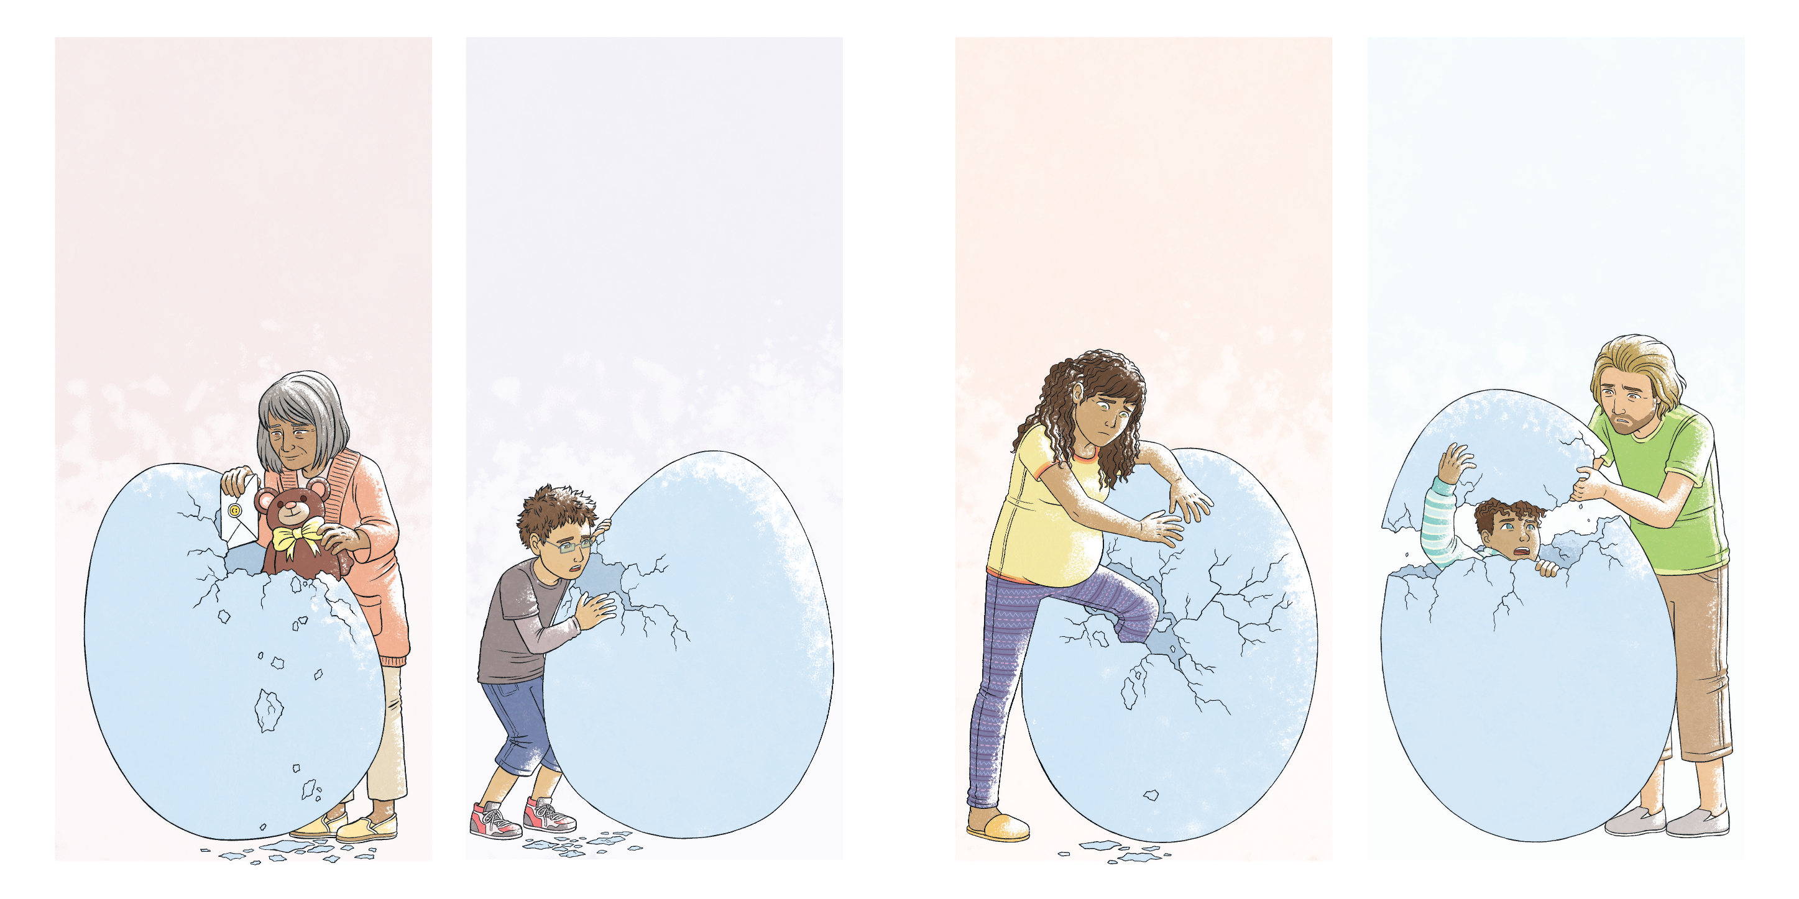
The people who loved Enzo were worried about him. They tried to help, but they weren’t sure how.
One day, Nonna delivered a toy to distract him and a card to cheer him up...
...but it didn’t cheer Enzo up for long.
The following week, Enzo’s cousin, Mateo, started to ask him lots of questions...
...but Enzo didn’t know the answers.
On a Monday, his mum tried to come inside...
...but that day, Enzo wanted to be alone.
“Isn’t it time you stepped out?” Uncle Noah asked one Saturday...
...but Enzo didn’t feel ready to step out.

Slide 7
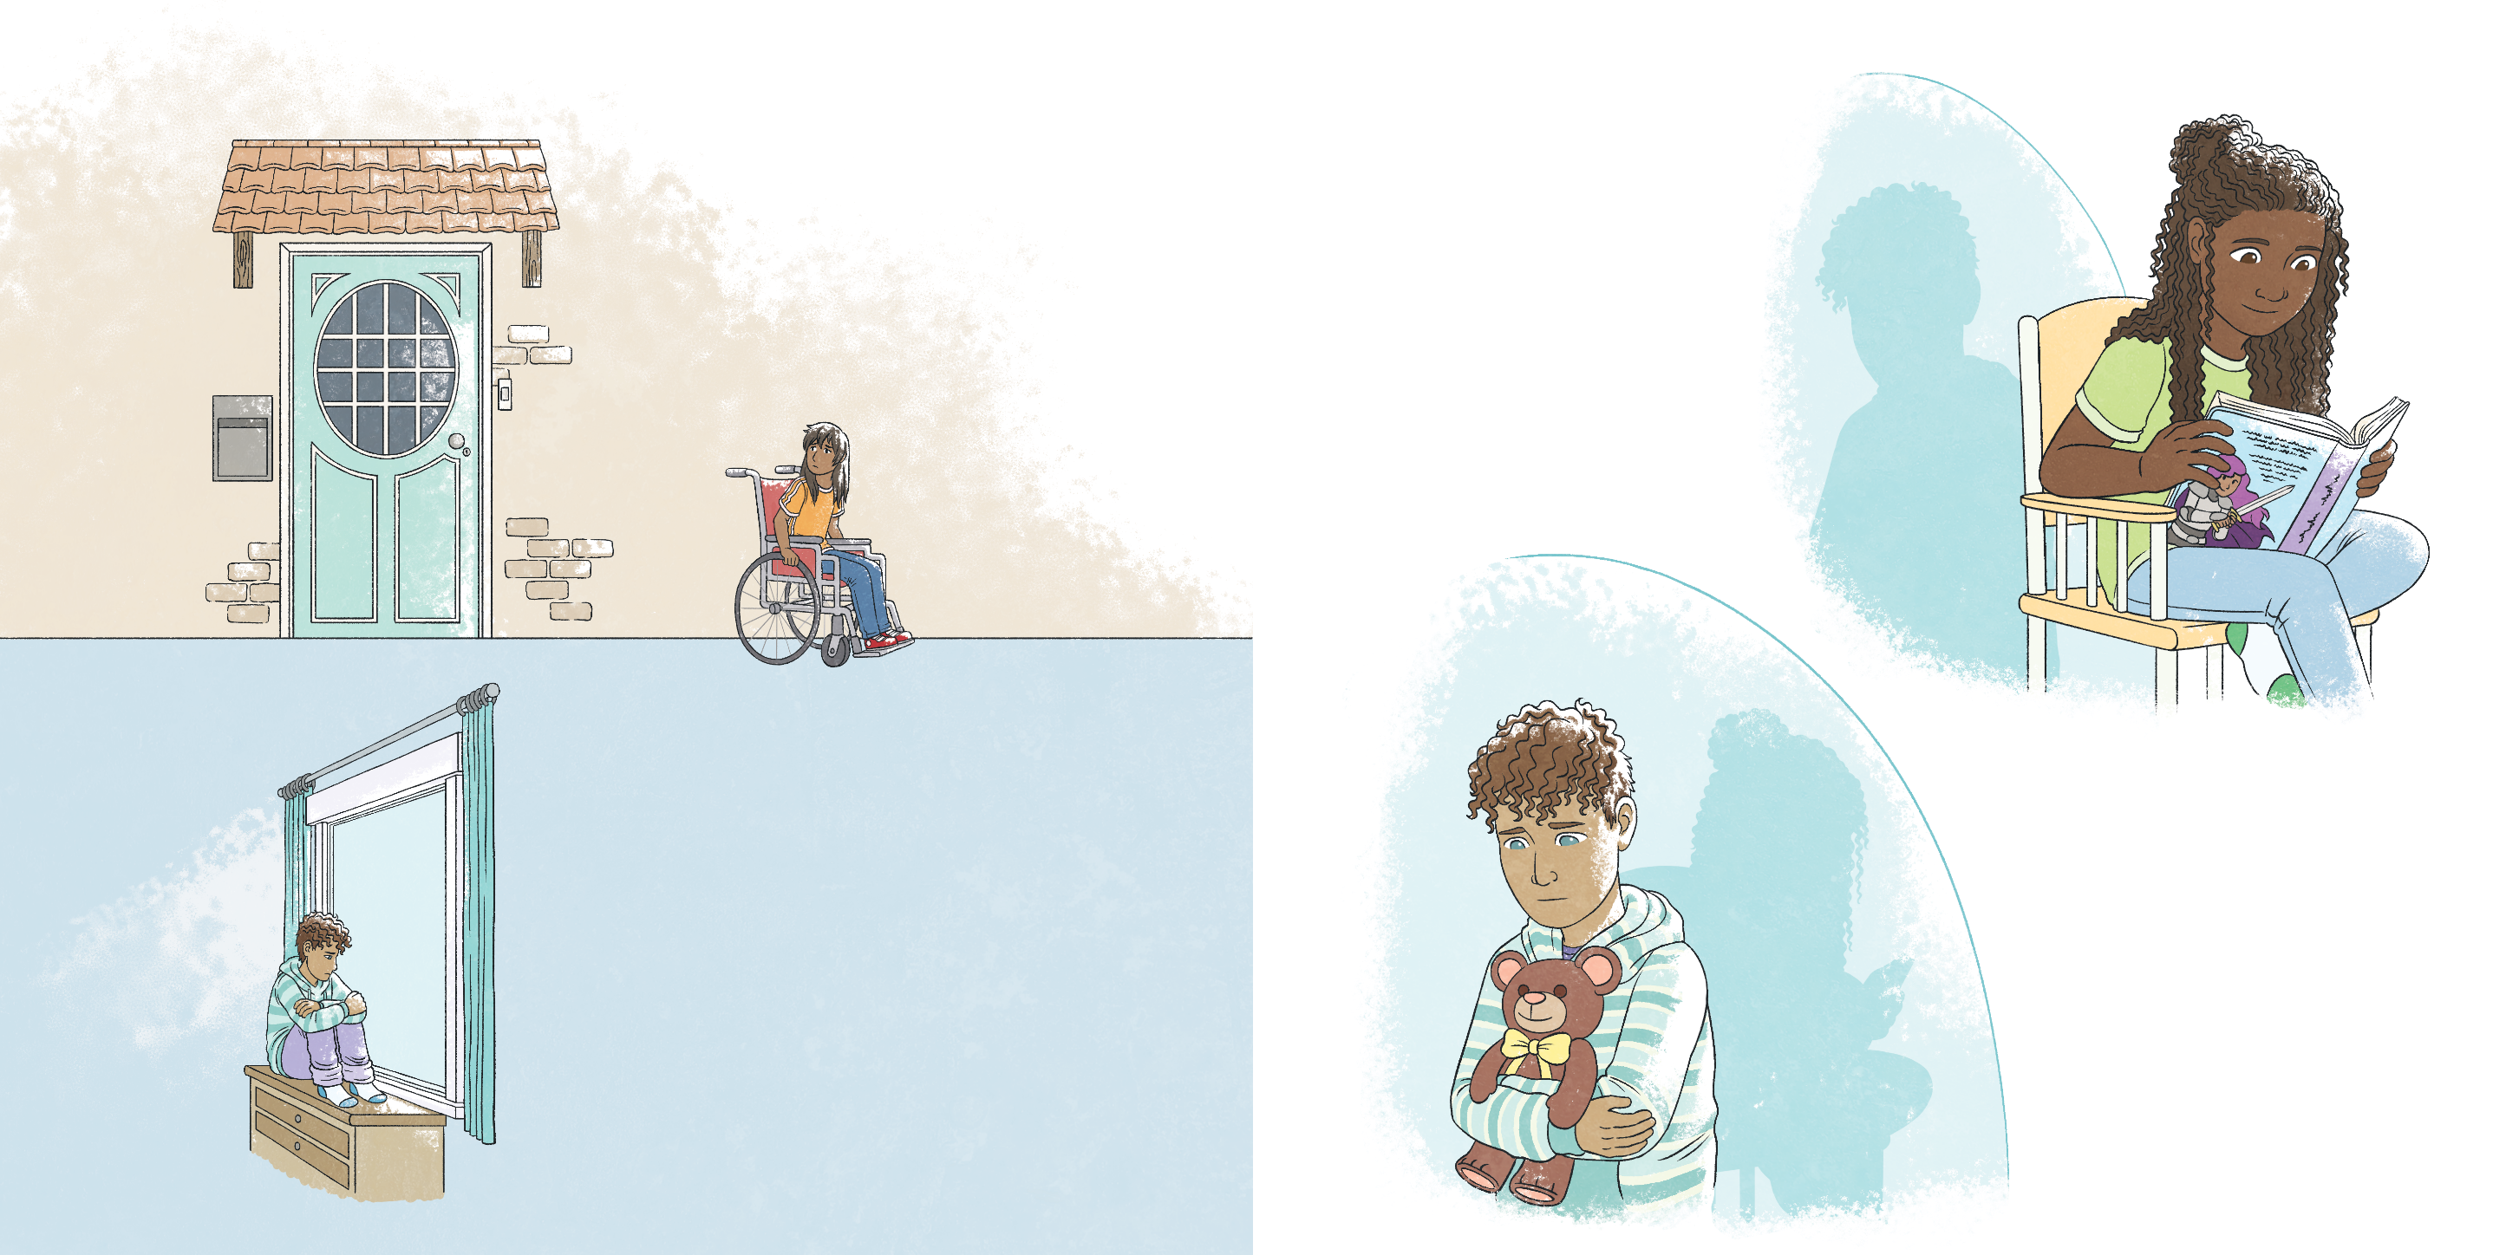
Enzo’s friend, Sarah, thought that he might want to be left alone so she stopped coming round to see him.
However, there was one person who seemed to understand exactly
how to help Enzo.
Tess knew that his egg needed to stay intact.
This made Enzo feel worse.
So, nothing happened for a while.

Slide 8
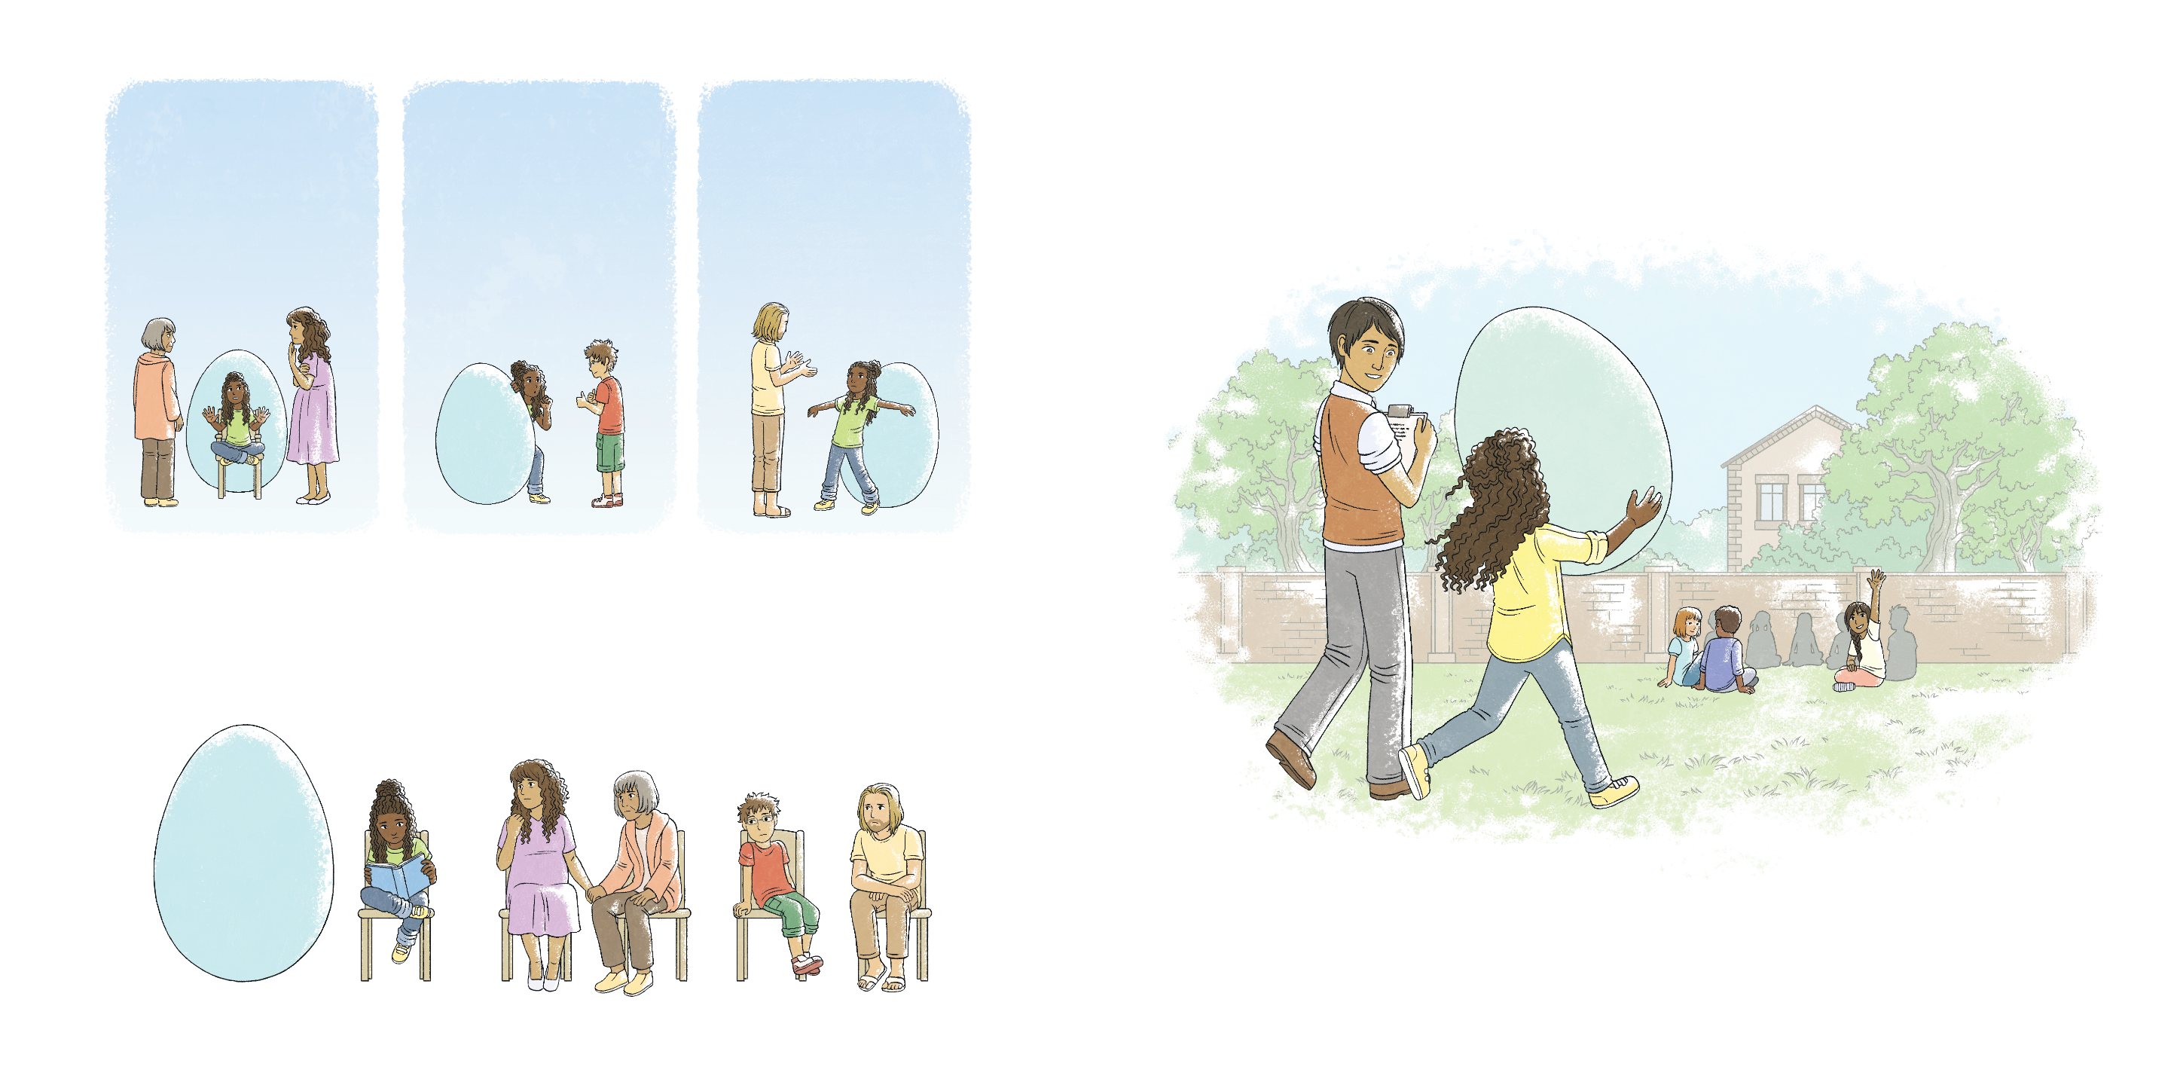
Nobody tried to force Enzo to come out of his egg.
When Tess was around, Enzo felt included. She always invited him to be part of the game… even when he didn’t feel like having fun.
Nobody tried to come inside.
Nobody tried to make any holes.
The egg was given time to heal, with Enzo inside. Yet he didn’t feel alone.
By being patient, Tess was able to make him feel welcome without forcing him to join in.

Slide 9
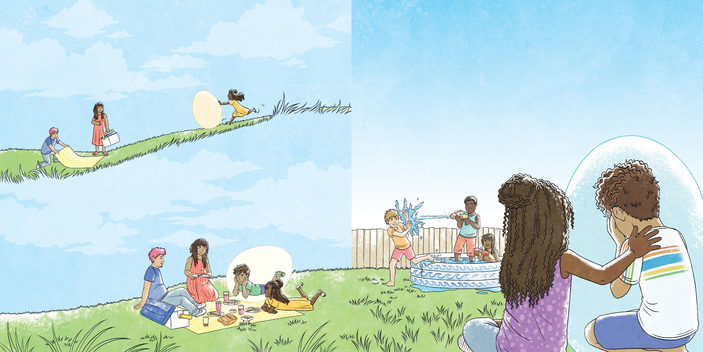
When Tess was around, Enzo felt listened to. She always invited him to be part of the conversation… even when he didn’t have much to say.
When Tess was around, Enzo felt supported. She always encouraged him to be honest about how he felt… even when he didn’t know how to express himself.
It wasn’t always easy. Some days were harder than others but, by not giving up, Tess gave Enzo the freedom to feel all his different emotions.
By listening to him, Tess was able to follow his lead. They chatted when he wanted to chat and shared some quiet time when he didn’t.

Slide 10

No matter how long it took, Tess was always there. Her friendship meant that Enzo knew it was OK for him to stay exactly where he was…
...for as long as he needed to.
When Tess was around, Enzo knew he was surrounded by
friends… even when he felt withdrawn.
By setting an example for others, Tess was able to show Enzo that his friends and his life were always there waiting for him, whenever he was ready.

Slide 11

One day, he reached out.
Another day, he watched.

Slide 12
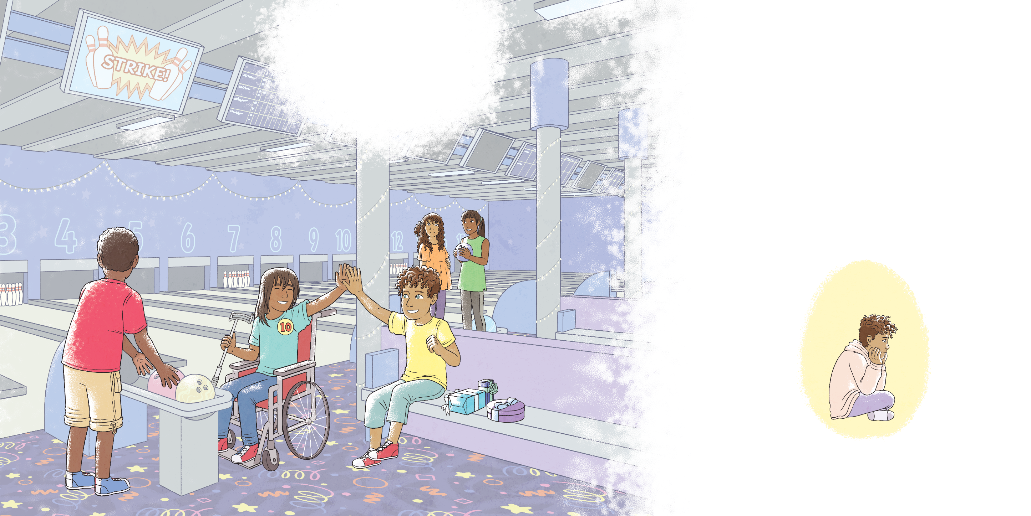
When he was ready, he stepped out...
...before stepping back in again.

Slide 13
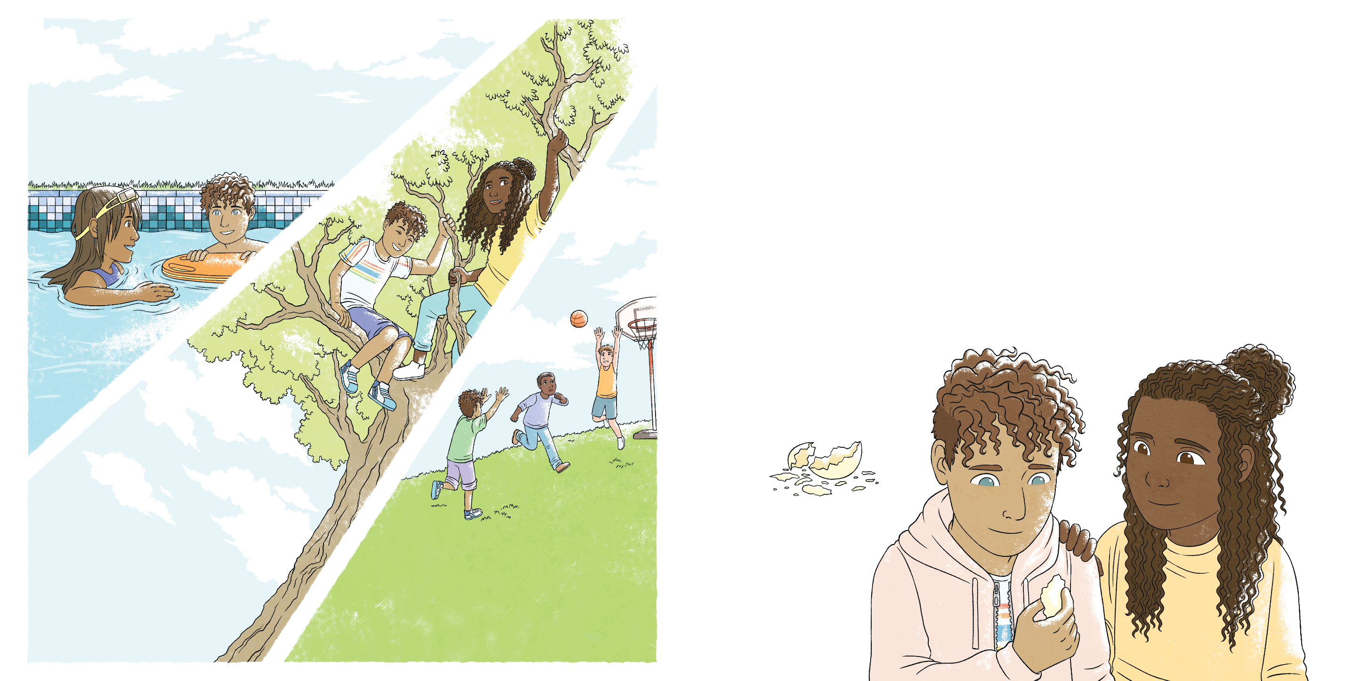
Then after a while, Enzo stayed out of the egg for longer…
So he decided to stay for a while,
but he always kept a little piece of the egg with him...
...just in case he needed to go back inside again one day.
...and longer…
...until Enzo realised that outside of the egg was where he wanted to be.

Slide 14
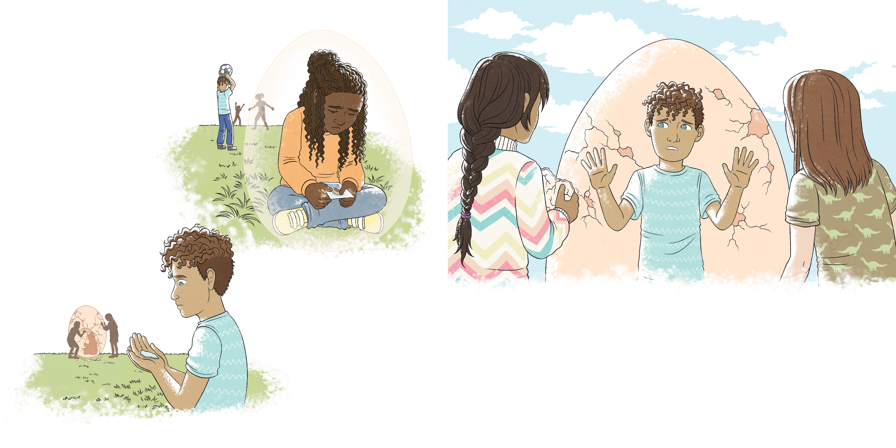
A little while later, Enzo noticed that Tess wasn’t herself.
Enzo didn’t need to know or understand exactly what Tess was feeling to be able to help her.
He thought back to how Tess had supported him and he knew just what to do.

Slide 15
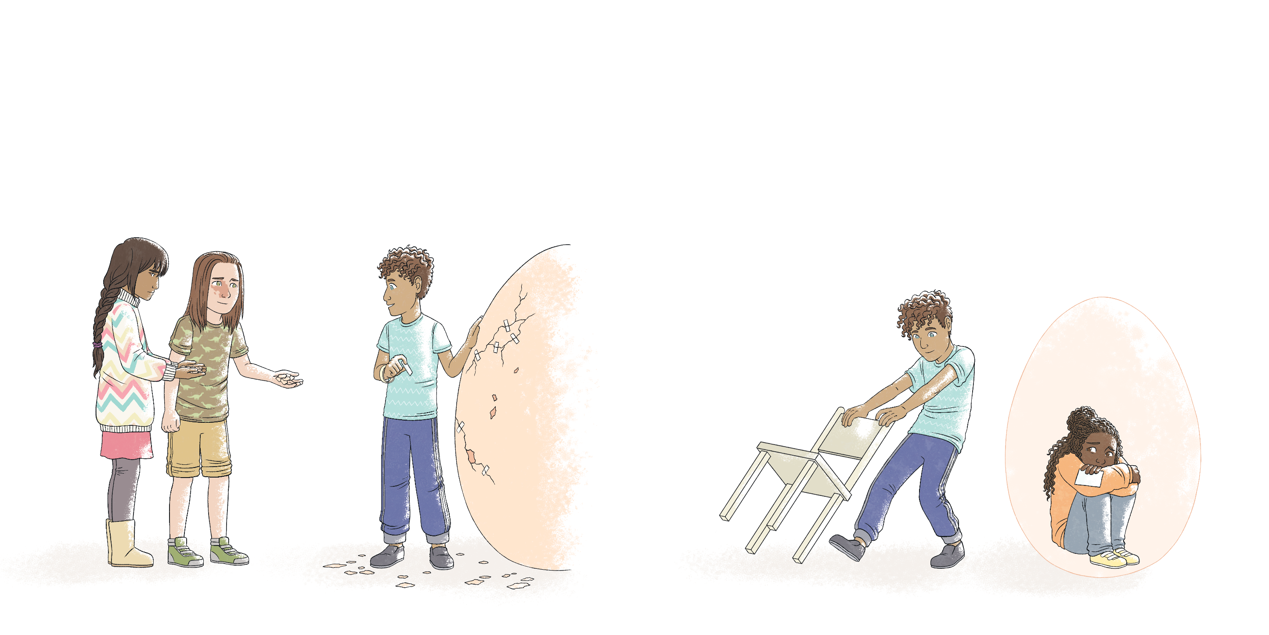
He was patient with Tess, giving her the time that she needed.
He listened to Tess, following her lead.

Slide 16
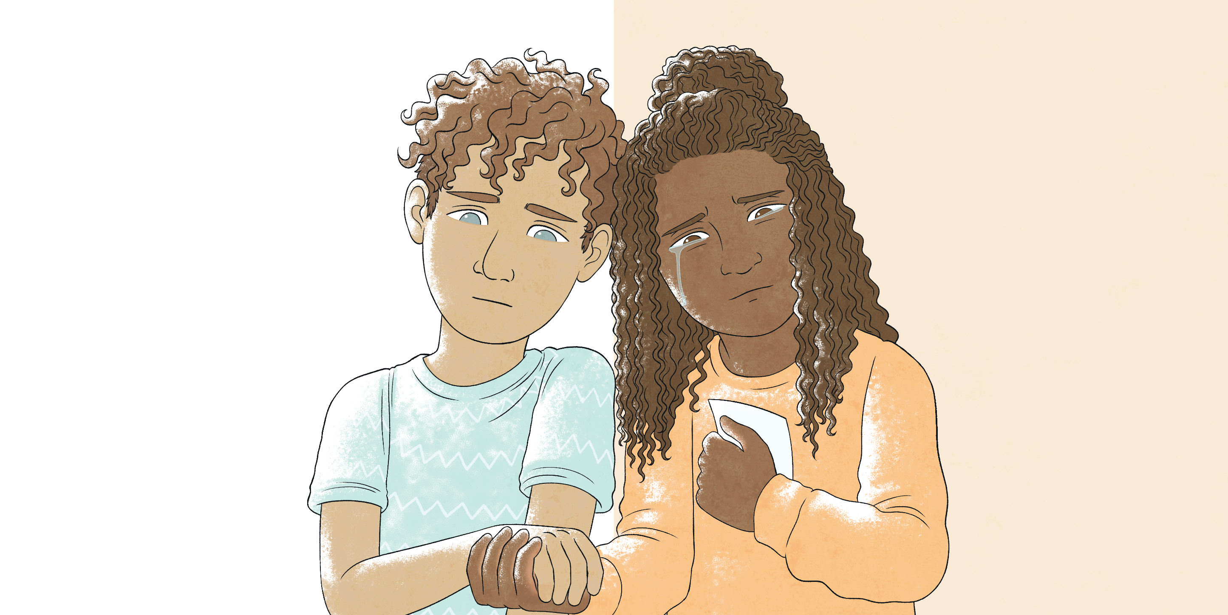
He showed Tess that she was loved, that he would never give up on her and that he would always be her friend.
He supported Tess, carrying her with him but never forcing her to join in.

Slide 17
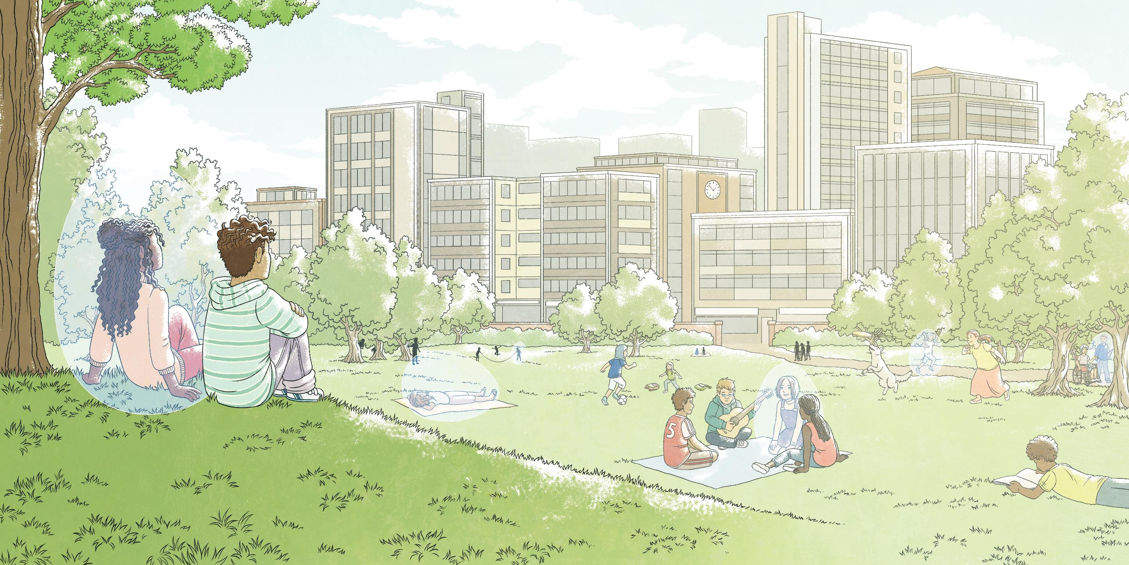

Slide 18


