Slide 1
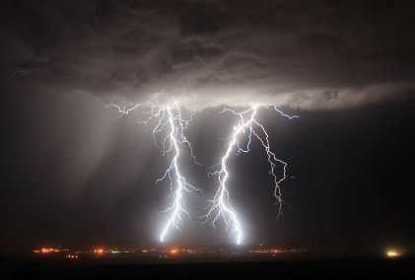
PSHC
This term we are exploring ‘Being Me in My World’. We will be thinking about rights, responsibilities, recognising achievements, and talking about emotions.
RE
This term we are learning about ‘Why are some places special’? We will be paying particular attention to Hinduism and comparing it to Christianity. We will be exploring places we feel special and places of worship.
Geography
This term we are learning about ‘Weather’. We will start by learning about different types of weather and then moving on to collecting weather data and talking about the effects of climate change.
Year 1
Term 1
Science
This term we are learning about materials. We will be looking at the properties of materials and then carrying out some experiments to find out the best material for different purposes.
DT
Linking with our English unit, we are going to be looking at mechanisms. We will be making lever, slider and wheel mechanisms.
PE
In PE will be looking at our Coordination and Static Balance by learning different movements (galloping, side stepping, skipping) and practising balancing on both the dominant and non-dominant leg.

Slide 2
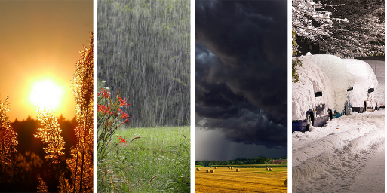
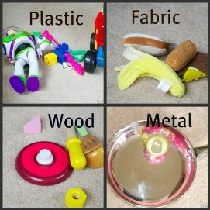
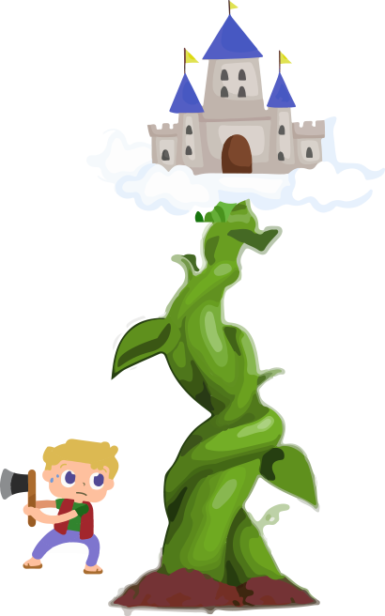
Optional Extra Activities
Maths
Order and compare numbers to 20.
Count to 100.
Number bonds to 5 and 10.
Science
Go on a material hunt and try and spot lots of different materials.
Collect materials at home and sort them either based on their material or whether they’re hard/soft etc.
Geography
RE
Make a weather chart and collate data on the different weather over a month.
Talk about where a special place might be at home. What makes it special?
What special places can you see out and about that may be special for different people?
PSHC
Draw a picture of a time when you felt really proud of yourself. What is something you want to be able to do?
English
Look at the story ‘Jack and the Beanstalk’ on YouTube. Then imagine that you climbed up the beanstalk. Act out with your family what would happen when you climb the beanstalk. Discuss how you would be feeling. Can you write a sentence about your experience?
DT
Practise making different mechanisms at home – can you make your own lever mechanism?

