Slide 1
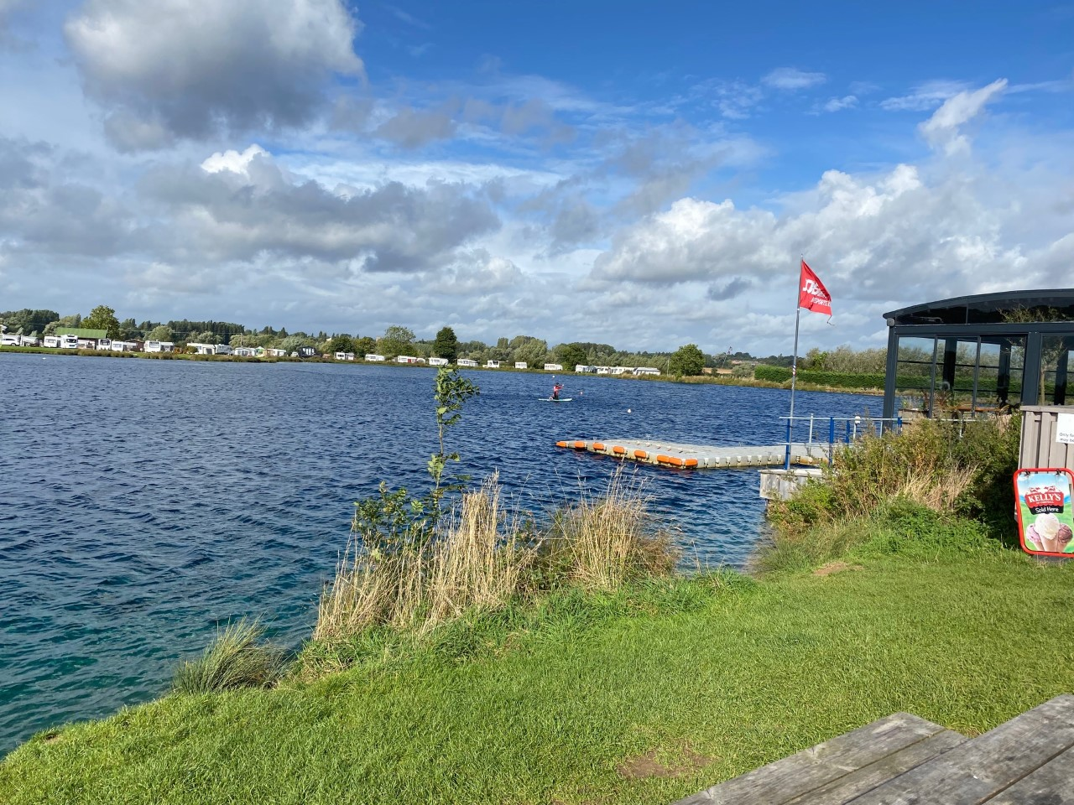
Holymead Year 6 Residential 2023
Mon 17th April –Friday 21st April 2022
https://www.croftfarmwaterpark.com/

Slide 2
Ethos of camp
The ethos of the camp is very much to encourage to children to take part in as many activities as they can.
No one is forced to take part in activities if there are things that they don’t feel comfortable with.
However, more often than not, once the children have see their peers taking part, they usually decide to as well.

Slide 3
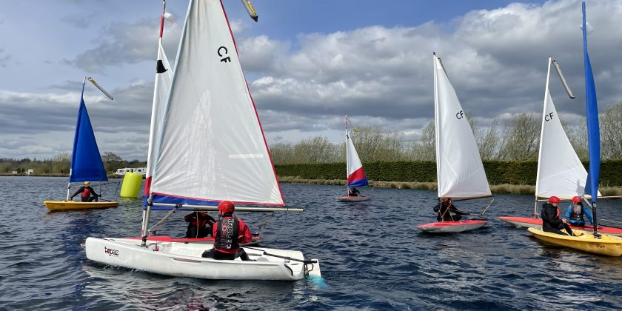
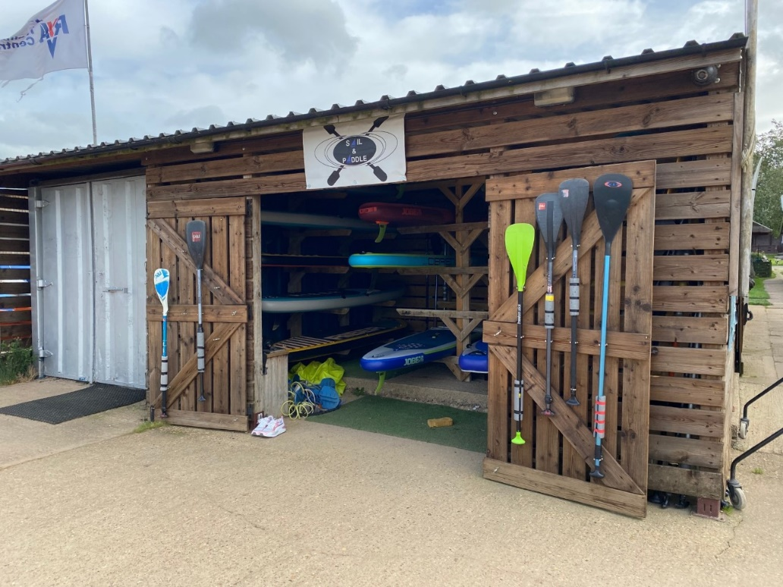
Activities
Staff are trained to the national standard and have lots of experience
These will include activities such as:
Kayaking
Canoeing
Climbing wall / abseiling
Archery
Raft building
Nb: activities will be confirmed 2 weeks before departure
Children will be working in groups of 12.

Slide 4
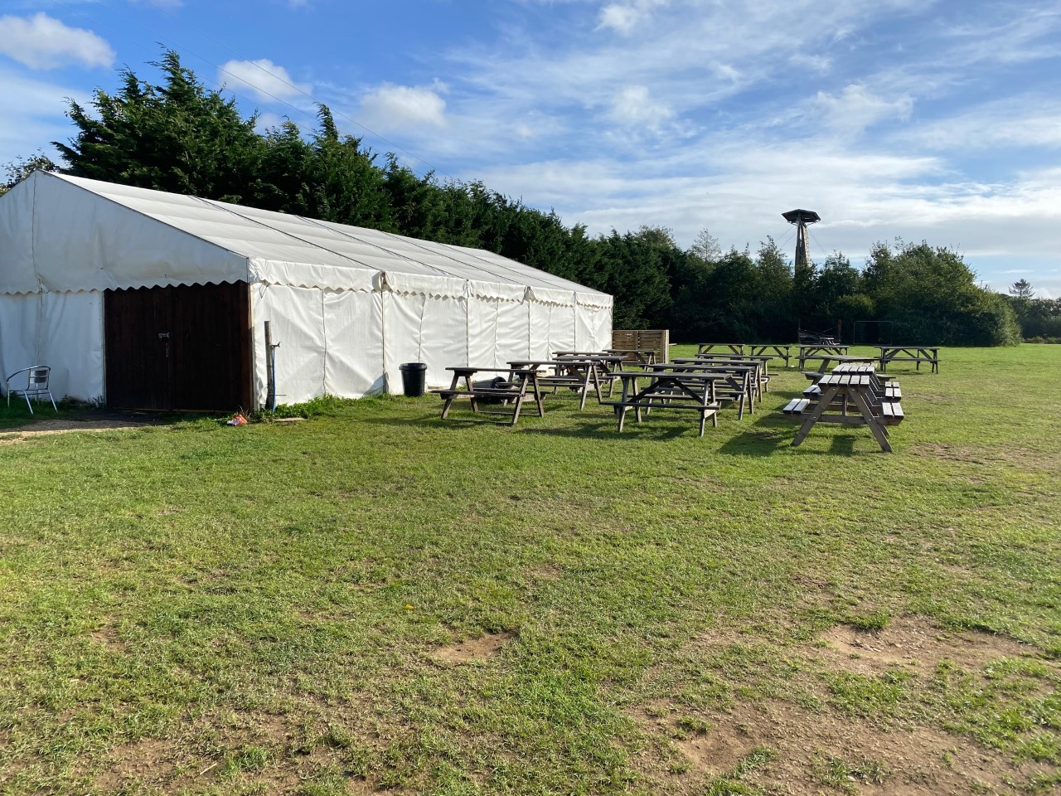
Activities
Water activities will be 3 hours long alongside a land based activity lasting 1 ½ hours.
This will then be followed by an evening activity.
There will also be some opportunities for free time
Nb: activities will be confirmed 2 weeks before departure
Activities will run on into the evening

Slide 5
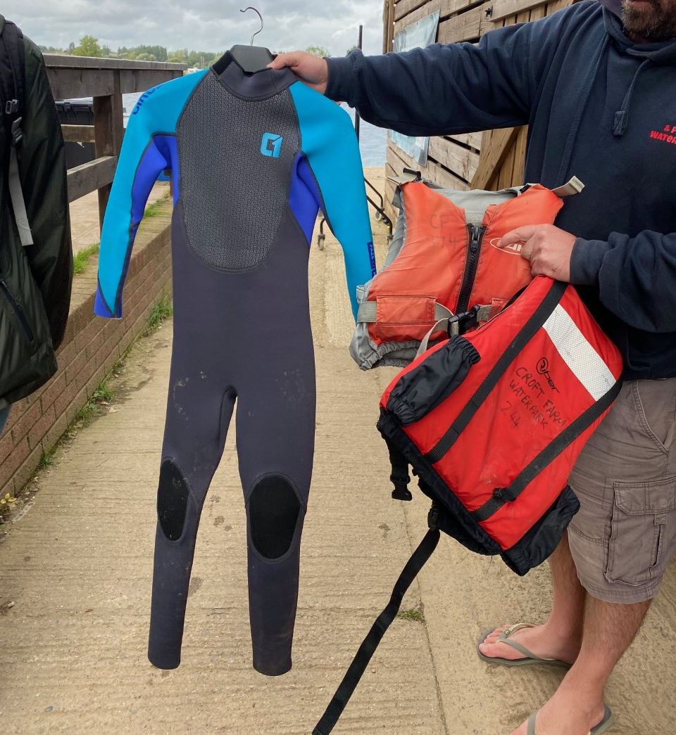
Activities
These will include activities such as:
Kayaking
Canoeing
Climbing wall / abseiling
Archery
Raft building
Nb: activities will be confirmed 2 weeks before departure
All kit is provided and as expected, all children will wear life jackets whilst taking part in water sports

Slide 6
A typical day

Slide 7
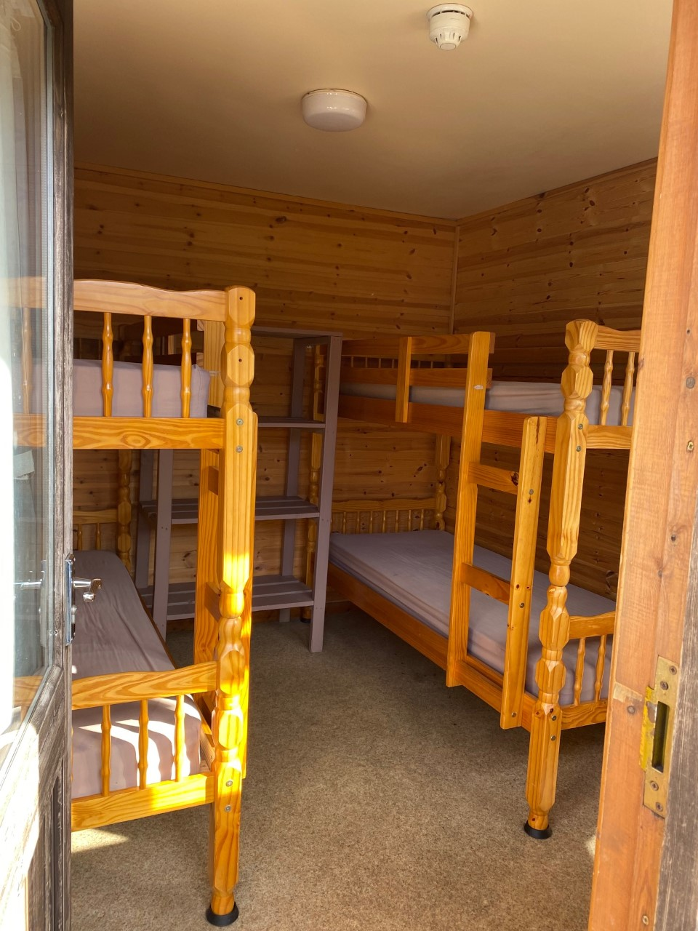
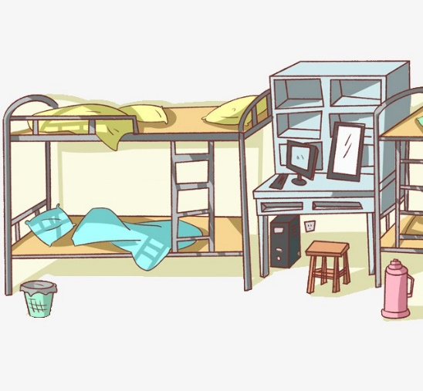
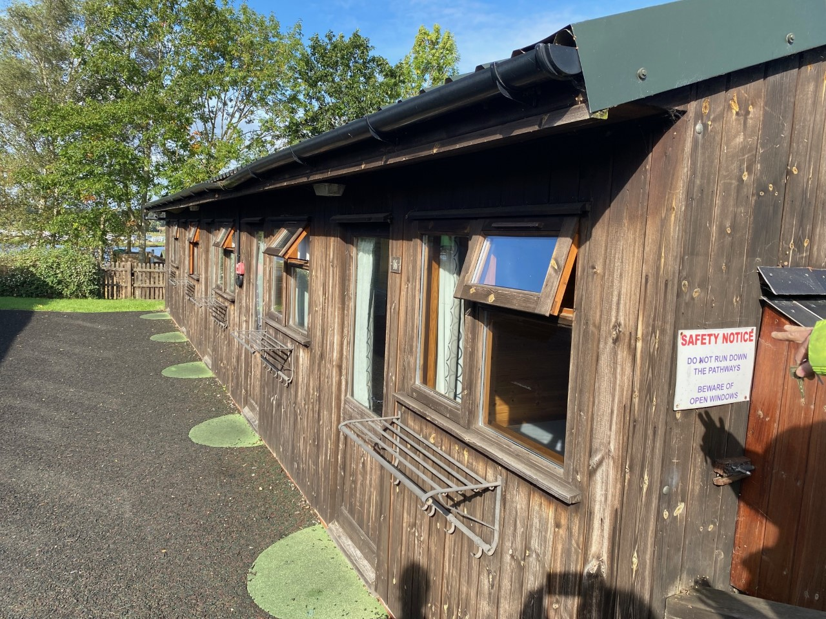
Sleeping arrangements
Children sleep in dorms of 4.
We will organise which room the children will sleep in but please be reassured they they will be placed with their friends.
There will be a member of staff on each end of the dormitories and the area is secured.

Slide 8
There is a separate toilet and shower block for girls and boys
Water refill station and handwashing spot too.

Slide 9
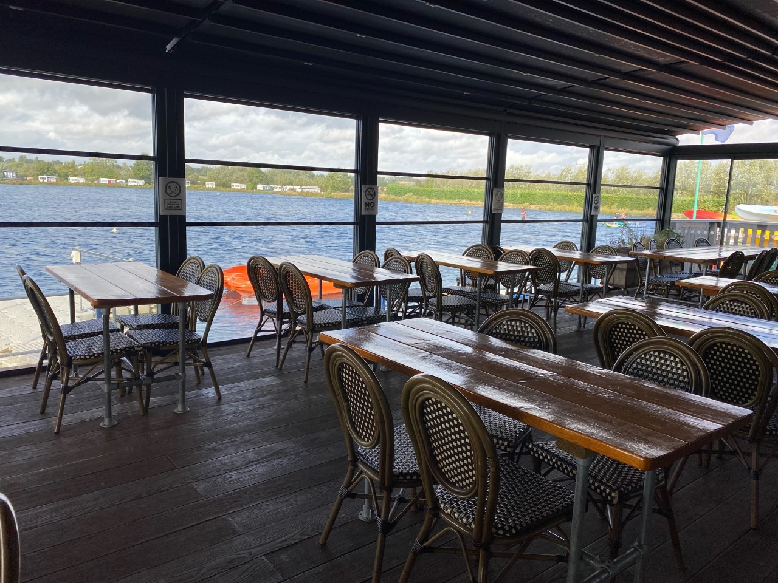
Meal times:
The camp has been informed of any dietary requirements

Slide 10
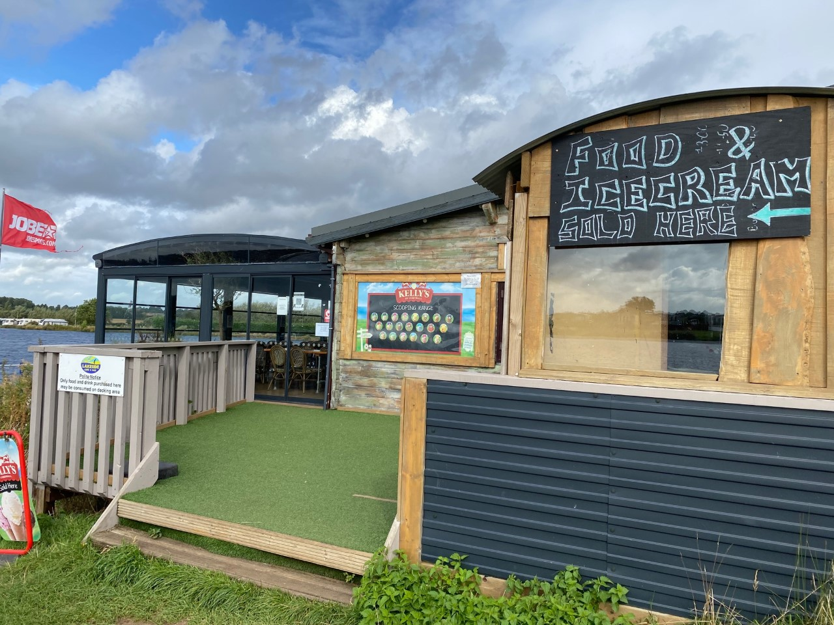
Pocket money
There is a small shop for children to buy snacks.
Bring up to £10 in pound coins

Slide 11
What to bring
Sleeping bag and pillow
Lots of layers
Old trainers – a couple of pairs if possible
Waterproof / windproof jacket
Note:
Jeans aren’t a great idea as they become heavy an uncomfortable if they get wet.
Lots of jogging bottoms / legging and layers is ideal.
Get your child to pack themselves as much as possible so they know what they’ve brought and will know if they've lost anything
For more detailed information, please see the kit list on the Year 6 page of the website.
http://www.holymeadp.bristol.sch.uk/web/year_6_7/467196
Phones are not permitted!

Slide 12
Medical information
Medical forms:
These can be found on Year 6 page of the website.
Please ensure you have included all of the information required.
We will be asking for these to start coming in after Christmas

Slide 13
Payments:
Price of camp: 341: 00 (including £80 deposit)
£87:00 to be paid by 13th December 2021
A further 87:00 to be paid by 28th February 2022
Final payment of £87:00 to be paid by 4th April 2022

Slide 14
Departure and arrival back to Holymead
Depart Holymead at 11 am on Monday 17th April
Bring your child in no later than 10 a.m
If you have work commitments that do not allow you to do this, bring your child in at the normal start of the school day (8:50)
Arrive back at Holymead approx. 2:30 on Friday 21st April
You can pick your child up once they arrive back at school (the office will parentmail when we arrive back).
Alternatively, you can pick them up at the end of the school day (3:20 p.m)

Slide 15
Information on the website

Slide 16
Queries
If you have any further queries, please call/ email the school and ask to speak to Miss O’Toole
In the meantime, take a look at the Croft farm website at:
https://www.croftfarmwaterpark.com/

