Slide 1
Tregoyd House 2019
Wales
Monday 17th June – Wednesday 19th June
Staff going – Mrs May, Ms Kosir, Miss Lynds, Mr Hough, Miss Nelmes and Mr Gratton

Slide 2
Activities
Need to be confirmed. We have requested these – Find out 4 weeks before – we can send this to you via parentmail. Kit list
Canoeing
Obstacle Course
Climbing
Abseiling
Orienteering
Zip wire / Climbing
Archery
disco on the final evening

Slide 4
Meal times
Breakfast and lunch we will have the dining room to ourselves.
Lunch we will be sharing with another school.
Lunches are staggered.
Menu on next page – any allergies are catered for.

Slide 5
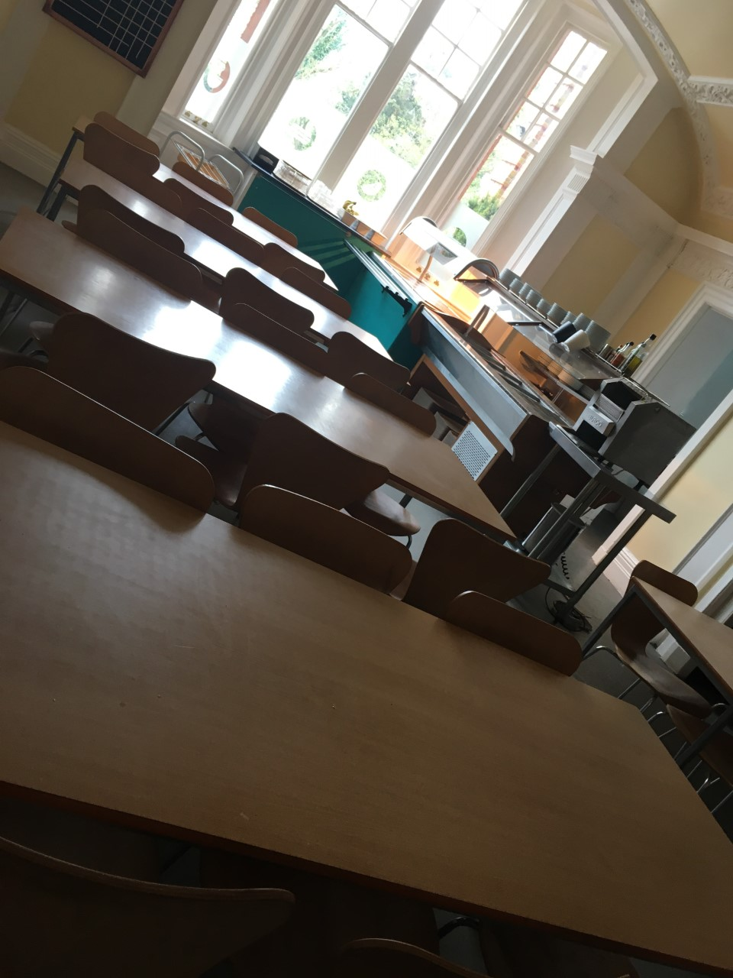

Slide 6
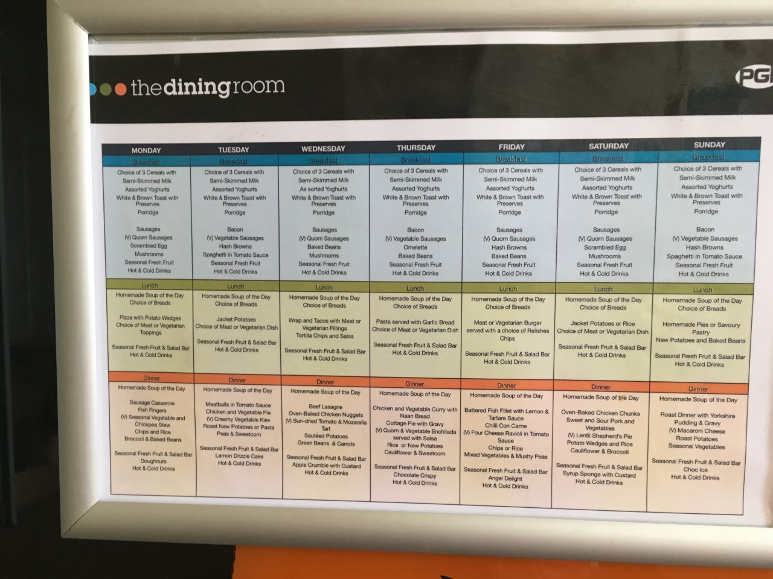

Slide 7
Ethos of the camp

Slide 8
Timings for the week
Monday 17th June
Children gather in Lower Hall at 8:50am. Coach departs at 9:30am.
Register and give medicines and money.
Wednesday 19th
^{Normally} back by the end of the school day. You will be informed by text if we are late. They are dismissed from lower hall.

Slide 9
On arrival
The children will eat lunch, unpack their bags and will begin their first activity. They will have a tour of the site first

Slide 10
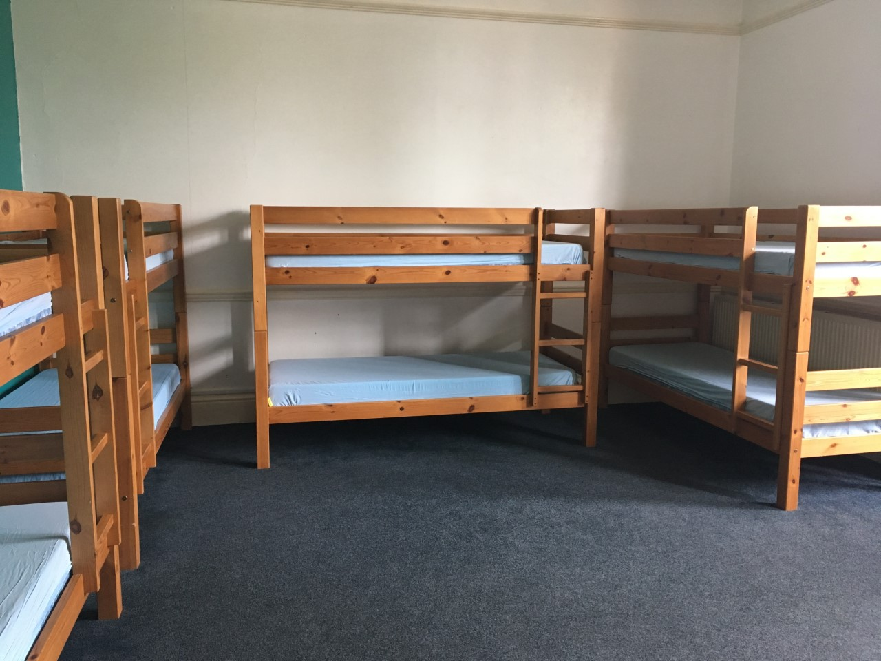
Sleeping and group arrangements

Slide 11
Medical information
Please ensure these are completed and given back promptly
You will need to bring any medication
You have mentioned on the forms.
We have calpol, sanitary towels, piriton
Sudocream and plasters. There is registered
First aider always on site.

Slide 12
What to bring!
Jeans aren’t a great idea! Apart from for DISCO NIGHT!
Get your child to pack themselves as much as possible so they know what they’ve brought and will know if they've lost anything
Phones are not permitted!

Slide 14
The children are split into groups of about 10. There is an adult from the school with them the whole time.
They are in these groups all day and mix for meal times.

Slide 15
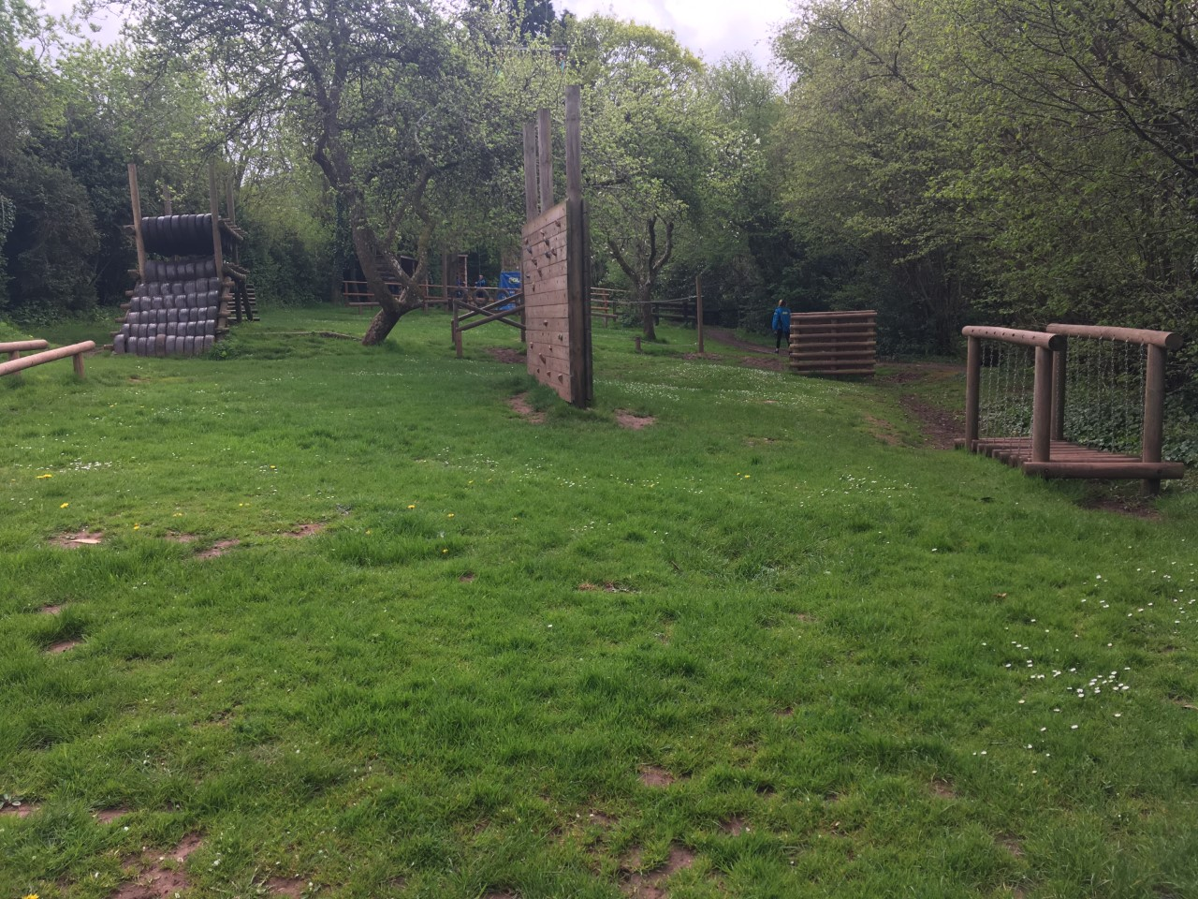

Slide 18
Any questions

